Slide 1
NLP Group at Jadavpur University, Kolkata, India
Computer Science and Engineering Department
  Teaching
    Natural Language Processing to students of Undergraduate and Masters’ students in Computer Science and Engineering
    Laboratory projects for students
  Research and Development

Slide 2
Research and Development in NLP
International Projects
  "Strategic India-Japan Cooperative Programme-Project" in the area of multidisciplinary ICT,
  Project Entitled:: "Sentiment Analysis where AI meets Psychology"
  Research Leader in Japan:: Professor Manabu Okumura, Precision and Intelligence Laboratory; Tokyo Institute of Technology, Japan

Slide 3
Research and Development in NLP
International Projects
  "INDO-FRENCH CENTER FOR THE PROMOTION OF ADVANCED RESEARCH (IFCPAR)", Govt. of India and France
  Project Entitled:: "An advanced platform for question answering systems"
  Principal Collaborator in France:: Prof Patrick Saint Dizier, Institut de Recherche en Informatique du Toulouse, Toulouse, France

Slide 4
Research and Development in NLP
International Projects
  CONACYT-DST India
Project Entitled:: "Answer Validation through Textual Entailment".
Principal Collaborator in Mexico:: Professor Alexander Gelbukh, Center for Computing Research, National Polytechnic Institute, Mexico City, Mexico

Slide 5
Research and Development in NLP
National Projects (Consortium Mode)
  Cross Lingual Information Access
    Snippet and Summary Generation
    Snippet Translation
  English to Indian Languages Machine Translation Systems
  Indian Language to Indian Languages Machine Translation Systems

Slide 6
NLP Manpower
Doctoral Students
  Statistical Machine Translation
  Answer Validation through Textual Entailment (joint supervision with Prof. Alexander Gelbukh)
  Opinion Mining
  Emotion Analysis
  Event Identification and Event – Time Analysis

Slide 7
NLP Manpower
Masters’ Students
  Multi Word Expressions
  Comparative and Evaluative Question Answering Systems
Undergraduate Students

Slide 8

Emotional Expression, Holder and Topic
– The Three Vertices of an Emotion Triangle
Prof. Sivaji Bandyopadhyay
Department of Computer Science & Engineering
Jadavpur University,
Kolkata-700032, India

Slide 9
Introduction
(Quan and Ren, 2009)
“Opinion Mining and Sentiment Analyses have been attempted with more focused perspectives rather than fine-grained emotion”
Emotion
- An aspect of a person's mental state of being, normally based in or tied to the person’s internal (physical) and external (social) sensory feeling (Zhang et al., 2008)

Slide 10
Introduction
Emotion
- A private state, not open to any objective observation or verification (Quirk et al., 1985)
- Direct affective word (“He is really happy enough”)
- Indirect notion (“Dream of music is in their eyes and hearts”)
- Difficult to identify emotional stance in text
- Need for Syntactic, Semantic and Pragmatic analysis of text (Polanyi and Zaenen, 2006)

Slide 11
Introduction
- Natural language text contains attitudinal information of a reader or writer with respect to some subject, event or topic
- Attitude may be
- Judgment
- Evaluation
- of a Reader
- of a Writer
“There is indeed a relationship between writer and reader emotions” ( Yang et al., 2009)

Slide 12
Emotion/Sentiment Triangle
Expression
Where from do we start ?
Lexicon and Corpus !
Holder
Topic

Slide 13
Emotion lexicon
Existing Resources
Development
- Updating
- Translation
- Sense Disambiguation
Evaluation

Slide 14
Existing Resources
(English)
WordNet (Miller, 1995)
- Contains no emotion specific information
WordNet Affect (Strapparava and Valitutti, 2004)
- A resource for SemEval-2007 shared task of “Affective Text”.
- In SemEval-2007, a set of words from WordNet Affect relevant to the Ekman’s (1993) six emotional labels (joy, fear, anger, sadness, disgust, surprise)
SentiWordNet (Esuli and Sebastiani, 2006)
- Assigns three sentiment scores such as positive, negative and objective to each synset of WordNet
Subjectivity Wordlist (Banea et al., 2008)
- Assigns words with strong or weak subjectivity and prior polarities of types positive, negative and neutral

Slide 15
Emotion lexicon
Existing Resources
Development
- Updating
- Translation
- Sense Disambiguation
Evaluation

Slide 16
Updating (1/4)
/* WordNet Affect Synset */
n#10337658 fit(A) scene(B) tantrum
/* SentiWordNet Synset for A’*/
tantrum/scene/conniption/fit/burst/fit_out/equip/outfit/tally/jibe/match/correspond/gibe/agree/check/conform_to/meet/set/primed/fit_to/fit_for/convulsion/paroxysm
/* SentiWordNet Synset for B’ */
tantrum/scene/conniption/fit/scenery/view/prospect/vista/panorama/aspect/shot
/* Updated Synset E’ */
tantrum/scene/conniption/fit/burst/fit_out/equip/outfit/tally/jibe/match/correspond/gibe/agree/check/conform_to/meet/set/primed/fit_to/fit_for/convulsion/paroxysm/scenery/view/prospect/vista/panorama/aspect/shot

Slide 17
Updating (2/4)
Updating Using SentiWordNet (SW) (Esuli and Sebastiani, 2006)
- Replace each word in the WordNet Affect by equivalent retrieved synsets of SentiWordNet if the synsets contain that emotion word
- Part of speech (POS) information considered
- Subjective score is not considered
Updating Using VerbNet (VN) (Kipper-Schuler, 2005)
- Largest online verb lexicon with explicitly stated syntactic and semantic information based on Levin’s verb classification
- VerbNet files that are stored in an XML format contain member verbs with similar sense
- Member verbs present for a specific class are sense based synonymous verbs and create verb synsets from each VerbNet class
- Each word present in a verb synset (identified by “v” POS category in Wordnet Affect lists) is updated with VerbNet synset
- Duplicate Removal Strategy

Slide 18
Updating (3/4)
Duplicate Removal
If the words “A” and “B” in WordNet Affect entry “E” are replaced by the retrieved SentiWordNet synsets A’ and B’ such that A1, A2, A3, B3 є A’ and B1, B2, B3, A3 є B’
then the updated entry E’ = (A’ – B’ ) + (B’ – A’) + (A’ ∩ B’ ). The A1, A2 and A3 are the words present in the retrieved synset A’ and B1, B2, B3 are in retrieved synset B’ as extracted from SentiWordNet
B1
A1
B3
B1
A1
B2
A
B
A2
B’
A2
B3
A3
B2
A’
A3
E
E’

Slide 19
Updating (4/4)
WAL Class | Before Update Words (Synsets) | After Update using SW Words (Verb Synsets) | After Update using VN Words (Verb Synsets)
Anger | 318 (128) | 544 (39) | 765 (56)
Disgust | 72 (20) | 104 (12) | 195 (25)
Fear | 208 (83) | 371 (32 | 566 (51)
Joy | 539 (228) | 904 (44) | 1824 (69)
Sad | 309 (124) | 309 (28) | 852 (39)
Surprise | 90 (29) | 99 (28) | 260 (53)
Table 1: Update of English WordNet Affect using SentiWordNet and VerbNet

Slide 20
Emotion lexicon
Existing Resources
Development
- Updating
- Translation
- Sense Disambiguation
Evaluation

Slide 21
Translation (1/2)
Samsad Bengali to English bilingual dictionary is available
(http://home.uchicago.edu/~cbs2/banglainstruction.html)
English-to-Bengali bilingual synset based dictionary containing approximately 1,02,119 entries is being developed as part of the EILMT project
(English to Indian Languages Machine Translation (EILMT) is a TDIL project undertaken by the consortium of different premier institutes and sponsored by MCIT, Govt. of India)
Convert the Affect word lists into Bengali using the dictionary followed by manual updates
Word combinations or idioms are not translated automatically
Total number of non-translated words in the six emotion lists is 210
→ figure is comprehensible for manual translation

Slide 22
Translation (2/2)
Example of a Translated Synset
WAL Class | Translated Words (Synsets) | Non-translated Words
Anger | 1141 (321) | 80
Disgust | 287 (74) | 37
Fear | 785 (182) | 27
Joy | 1644 (467) | 42
Sad | 788 (220) | 10
Surprise | 472 (125) | 14
Table 2: Results of the Translation

Slide 23
Emotion lexicon
Existing Resources
Development
- Updating
- Translation
- Sense Disambiguation
Evaluation

Slide 24
Sense Disambiguation (1/3)
Bengali-English bilingual dictionary
(http://home.uchicago.edu/~cbs2/banglainstruction.html)
Synonymous Word Set (SWS)
< [ kruddha ] a angry; angered, enraged; wrathful; indignant …>
< [ kruddha ] a SWS1;SWS2;SWS3;SWS4; …>
Hypothesis:
“ Two words belonging to same or different translated synsets are grouped together to form a new Bengali synset if there is at least one common English equivalent word present in any formed SWSs for those words ”
Notes:
SVS in detail for this Bengali verb

Slide 25
Sense Disambiguation (2/3)
SWS1
Example
SWS2
Xb
SWS1
Yb
SWS2
Ze
Example Synset
Notes:
Prepare a detailed example

Slide 26
Sense Disambiguation (3/3)
- Xb and Yb are two Bengali words
- Cxb and Cyb are English equivalent classes of Xb and Yb
Cxb = {SWS1; SWS2; …..; SWSq}
Cyb = {SWS1; SWS2; …..; SWSp}
If for i = 1 to p, j = 1 to q , (SWSi ∩ SWSj) ≠ φ, or ∃ Ze | Ze € SWSi ∩ SWSj,
- Where Ze is an equivalent English word present in any of the Synonymous Word Sets (SWS) of Cxb and Cyb simultaneously
- Then a new Bengali synset with Xb and Yb is formed
New English equivalent class is formed by merging SWSs of both Cxb and Cyb
Process continues until any word in Bengali translated synset remains unclassified
Notes:
Why recursive classification?
Bengali synonyms are identified from the Bengali lexicon
It is not clear why all these classes are necesssary
Difference between key class and synonymous class
KSVS – Key SVS for the Bengali key verb
What is Member SVS

Slide 27
Emotion lexicon
Existing Resources
Development
- Updating
- Translation
- Sense Disambiguation
Evaluation

Slide 28
Evaluation (1/2)
Manual
Agreement (Cohen’s Kappa)
- Measures agreement between two raters who each classify items into some mutually exclusive categories
- Emotion words present in the translated Bengali synonym sets
- Binary decision (Yes /No)
- Agreement values from 0.44 to 0.56 gives a significantly moderate value

Slide 29
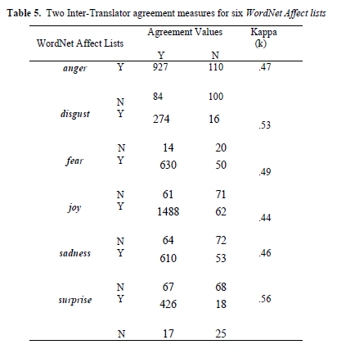
Evaluation (2/2)

Slide 30
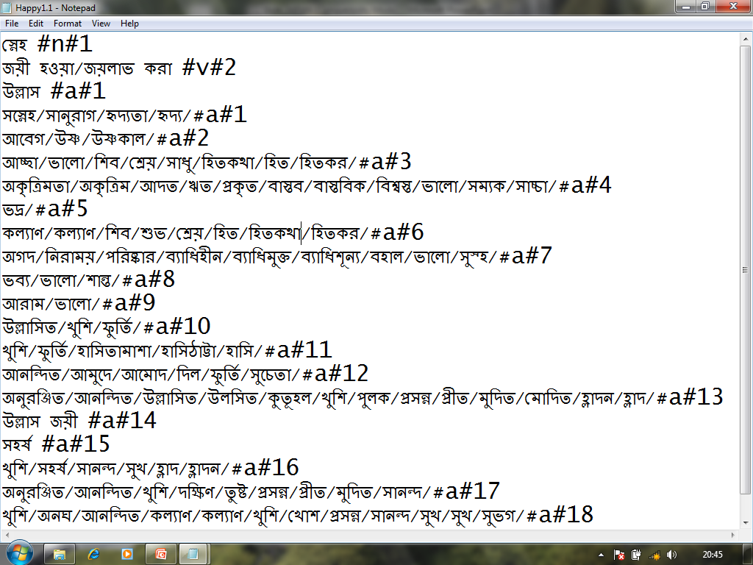
Bengali WordNet Affect Lists
Snapshot

Slide 31
Resources
Emotion Lexicon
- D.Das and S.Bandyopadhyay. 2010. Developing Bengali WordNet Affect for Analyzing Emotion. In the proceedings of the 23rd International Conference on the Computer Processing of Oriental Languages (ICCPOL-2010), pp. 35-40, California, USA
- Y. Torii, D. Das, S. Bandyopadhyay and M. Okumura. 2011. Developing Japanese WordNet Affect for Analyzing Emotions. In the Workshop on Computational Approaches to Subjectivity and Sentiment Analysis (WASSA 2.011), 49th Annual Meeting of the Association for Computational Linguistics (ACL), Portland, USA. (Accepted)

Slide 32
Emotion Corpus
Guideline (1/3)
Random collection of 123 blog posts from Bengali web blog archive (www.amarblog.com)
Total 12,149 sentences (comics, politics, sports and short stories)
Three Annotators
No prior training was provided to the annotators
Instruction based on some illustrated annotated samples
Open source graphical tool
(http://gate.ac.uk/gate/doc/releases.html)

Slide 33
Emotion Corpus
Guideline (2/3)
Items for Annotation
Emotional Expression (word / phrase)
Emotion Holder
Emotion Topic
Sentential Emotion
- Ekman’s (1993) six classes “anger”, “disgust”, “fear”, “joy”, “sad” and “surprise”
Sentential Intensity
- Low (L) , General (G) and High (H)

Slide 34
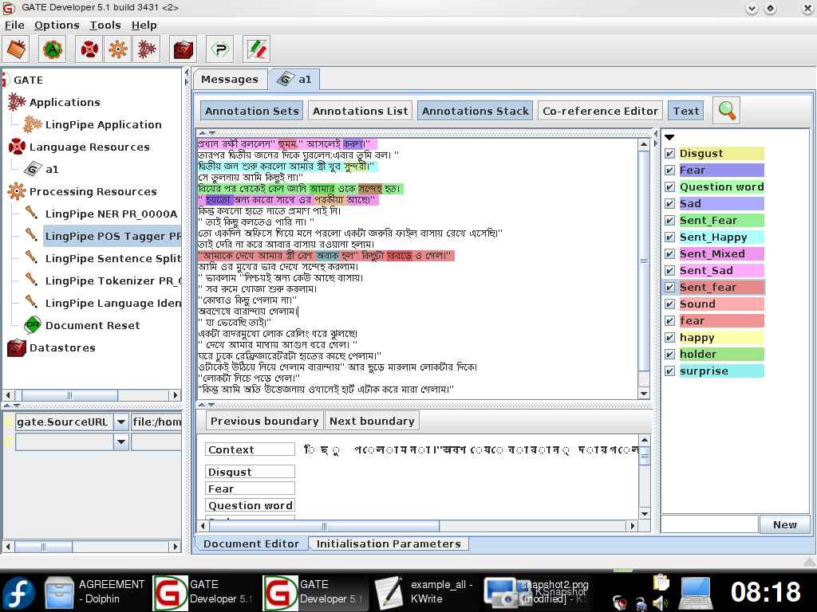
Emotion Corpus
Snapshot (1)

Slide 35
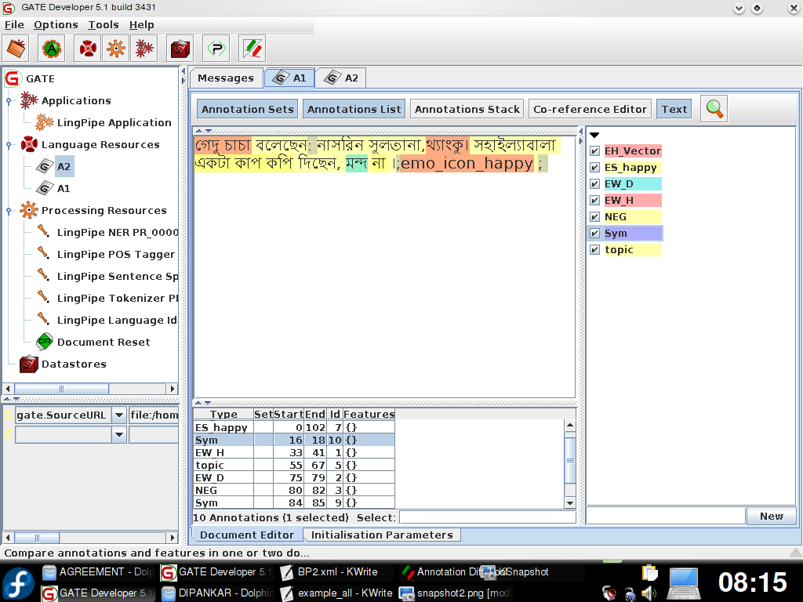
Emotion Corpus
Snapshot (2)

Slide 36
Emotion Corpus
Guideline (3/3)
Relaxed Scheme
- Annotators are free in selecting the texts spans (e.g. emotional expressions and topic)
Fixed Scheme
- Annotators are given emotional items with fixed text spans
(e.g. Emotion Holder, Sentential Emotion and Intensity)

Slide 37
Agreement (1/4)
Emotional expressions are words or strings of words
Agreement is carried out between the sets of text spans selected by two annotators
Strategies
- MASI (Measure of agreement on set-valued items) used in Co reference annotation (Passonneau, 2004), Semantic and pragmatic annotation (Passonneau, 2006)
- agr metric (Wiebe et al., 2005) for measuring directional agreement
- Cohen’s Kappa (κ) (Cohen, 1960)

Slide 38
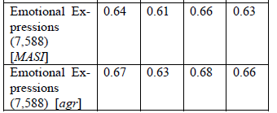
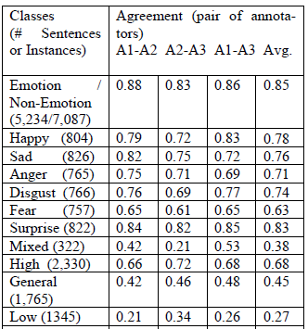
Agreement (2/4)
Emotional Expressions (MASI, agr)
Emoticons (Kappa)
Sentential Emotions and Intensities (Kappa)

Slide 39
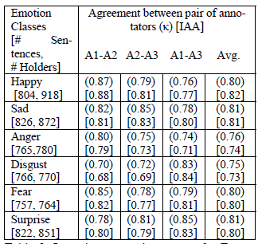
Agreement (3/4)
Emotion Holder
Cohen’s kappa (κ) (Cohen, 1960)
Inter Annotator Agreement IAA
- If X is a set of emotion holders selected by first annotator and Y is a set of emotion holders selected by the second annotator,
IAA = X ∩ Y / X U Y
Highly moderate for single emotion holder
Less for multiple holders
Disagreement occurs mostly for satisfying implicit constraints
Resolved the issues by mutual understanding
Emotion Holder (Kappa), [IAA]

Slide 40
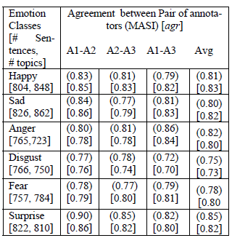
Agreement (4/4)
Emotion Topic
Topic consists of single or string of words
Scope of individual topics inside a target span is hard
Use of MASI and agr metric
Agreement for target span annotation is (≈ 0.9) → satisfactory annotation
Disagreement
- Less in sentences containing single emotion topic
- Selecting boundaries of topic spans
- Selecting emotion topic from other relevant topics
Emotion Topic (MASI), [agr]

Slide 41
Resources
Emotion Corpus
- D. Das and S. Bandyopadhyay. 2010. Labeling Emotion in Bengali Blog Corpus – A Fine Grained Tagging at Sentence Level. In the 8th Workshop on Asian Language Resources (ALR8), 23rd International Conference on Computational Linguistics (COLING 2010), pp. 47-55, August 21-22, Beijing, China

Slide 42
Example
John surprisingly narrated the actual story.
Evaluative Expression : surprisingly
Emotion Holder : <John>
Emotion Topic : story
রাশেদ অনুভব করেছিল যে রামের সুখ অন্তহীন ।
(Rashed) (anubhab) (korechilo) (je) (Ramer) (sukh)(antohin)
Rashed felt that Ram’s pleasure is endless.
Evaluative Expression : সুখ (sukh) ‘pleasure’
Emotion Holder : < writer, রাশেদ (Rashed), রাম (Ram)>
Emotion Topic : রামের সুখ (Ramer sukh) ‘Ram’s pleasure’

Slide 43
Salient Vertices
Evaluative Expressions (word/phrase/sentence/document level)
Holder Identification
Topic Detection

Slide 44
Evaluative Expressions
(word/phrase/sentence/document level)
Evaluative Expressions - Subjective or Objective
Subjective Expressions
- Positive or Negative (Sentiment)
- Beyond Sentiment or fine grained Sentiment
Emotional Expression (word or phrase) is the subjective counterpart
Ekman’s (1993) six universal emotions (joy / happiness, sadness, anger, disgust, fear and surprise)

Slide 45
Evaluative Expressions (word/phrase/sentence/document level)
(Ku et al., 2006)
- Word
- Phrase (Word + Context Features, e.g. intensifier, negation, conjunct)
- Sentence (syntax + semantics + pragmatics)
- Document
Hierarchical forward granular approach
word → phrase phrase → sentence sentence → document
word → sentence sentence → document
word → document
phrase → document

Slide 46
Word Level Tagging
Baseline System
- No prior knowledge regarding word features
- Six separate modules for six emotion classes
- Words passed through six separate modules
- Tag each word with the emotion class
Baseline System + Stemming + WordNet Affect Lists
- Stemming (Suffixes of Bengali Verbs depend on Tense, Aspect, and Person)
- Bengali Stemmer uses suffix list and for English, porter stemmer (Porter, 1997) / WordNet Morphological Analyzer (Miller, 1990)
- Evaluated using WordNet Affect lists (Strapparava and Valitutti, 2006; Das and Bandyopadhyay, 2010)
- 3.65% and 6.03% improvement over baseline system in average accuracies on Bengali and English test sets

Slide 47
Word Level Tagging
Machine Learning System (CRF, SVM)
Features (Das and Bandyopadhyay, 2009)
· POS information (adjective, verb, noun, adverb)
· First sentence in a topic
· SentiWordNet emotion word (delight…)
· Reduplication (so-so, good-good..)
· Question words (what, why…)
· Colloquial / Foreign words
· Special punctuation symbols (!,@,?..)
· Quoted sentence ( “you are 2 good man”)
· Sentence Length (>=8,<15)
· Emoticons ( ☺, 😐, ☹ ..)
Different unigram and bi-gram context features (word level as well as POS tag level) and their combinations

Slide 48
Sentence Level Tagging (1/2)
Sense_Tag_Weight (STW)
- Select the basic six words “happy”, “sad”, “anger”, “disgust”, “fear” and “surprise” as seed words for six emotions
- positive and negative scores from English SentiWordNet (Esuli and Sebastiani, 2006) for each synset in which each of the seed words appears
- Fix the average retrieved score as Sense_Tag_Weight (STW) of that particular emotion tag
Table 1: Sense_Tag_Weight (s)(STW) of six emotion tags

Slide 49
Sentence Level Tagging (2/2)
Sense_Weight_Score (SWS) for each emotion type
- SWS_{i}=(STW_{i}*N_{i})/(∑j=1 to 7 STW_{j}*N_{j}) | i Єj
- SWS_{i} is the Sentence level Sense_Weight_Score for the emotion type i
- N_{i} is the number of occurrences of that emotion type in the sentence
- Sentence level emotion tag SET = [max i=1 to 7(SWSi)]
- Sentences are of neutral type if for all emotion tags i, SWSi produced zero (0) emotion score
- Post-processing for handling negative words (Das and Bandyopadhyay, 2009)

Slide 50
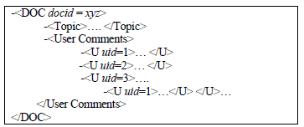
Document Level Tagging (1/2)
Heuristic features
- Emotion tags of the title sentence
- Emotion tags of the end sentence of a topic
- Emotion tags assigned to an overall topic
- Emotion tags for user comment portions of a document
- Most frequent emotion tags identified from the document
- Identical emotions that appear in the longest series of tagged sentences (Yang et al., 2007)
- Emotion tags of the largest section among all of the user comments’ sections
General Structure of a Bengali blog document

Slide 51
Document Level Tagging (2/2)
Document level Emotion_Weight_Score (EWS) for a particular emotion type
- EWSi = ∑ SWSi, where SWSi is the sentence level Sense_Weight_Score (SWS) for the emotion tag i in the document.
Assign Emotion_Weight_Scores (EWS) to each document for each of the six emotion types.
Document emotion tags DETi and DETj, for which EWSi is the highest and EWSj is the second highest Emotion_Weight_Score
- DETi = [Max i=1 to 6(EWSi)] and DETj = [Max j=1 to 6 && j ≠ i (EWSj)].
Heuristic features and their combinations have been considered during word level tagging

Slide 52
Evaluative Expressions (word/phrase/sentence/document level)
Publications (Journal )
- D.Das and S.Bandyopadhyay. 2010. Sentence Level Emotion Tagging on Blog and News Corpora, Journal of Intelligent System (JIS), vol. 19(2). pp. 125-142.
(Conference)
- D.Das and S.Bandyopadhyay. 2009. Word to Sentence Level Emotion Tagging for Bengali Blogs. Joint conference of the 47th Annual Meeting of the Association for Computational Linguistics and the 4th International Joint Conference on Natural Language Processing of the Asian Federation of Natural Language Processing (ACL-IJCNLP-2009), In the proceedings of short paper, pp.149-152, Suntec, Singapore.
- D.Das and S.Bandyopadhyay. 2009. Sentence Level Emotion Tagging. 2009 International Conference on Affective Computing & Intelligent Interaction (ACII-2009). DOI:10.1109/ACII.2009.5349598, pp. 375-380, Amsterdam, Netherlands.

Slide 53
Evaluative Expressions (word/phrase/sentence/document level)
- D.Das and S. Bandyopadhyay. 2009. Emotion Tagging – A Comparative Study on Bengali and English Blogs. In the proceedings of 7th International Conference on Natural Language Processing, (ICON-2009), pp. 177-184, Hyderabad, India.
- D.Das and S.Bandyopadhyay. 2009. Analyzing Emotion in Blog and News at Word and Sentence Level. Web 2.0 and Natural Language and Engineering Tasks Workshop at the 4th Indian International Conference on Artificial Intelligence (IICAI-2009), Bangalore.
- D.Das and S.Bandyopadhyay. 2010. Sentence to Document Level Emotion Tagging – A Coarse-grained Study on Bengali Blogs. In the proceedings of 2nd Mexican Conference on Pattern Recognition (MCPR-2010), Mexico
- D. Das and S. Bandyopadhyay. 2010 Identifying Emotional Expressions, Intensities and Sentential Emotion Tags using A Supervised Framework. 24th Pacific Asia Conference on Language, Information and Computation (PACLIC 2010), November 4-7, Sendai, Japan.

Slide 54
Emotion/Sentiment Triangle
Expression
Holder
Topic

Slide 55
Salient Roadmap
Evaluative Expressions (word/phrase/sentence/document level)
Holder Identification
Subject/Topic/Event Detection

Slide 56
Holder Identification
Emotional Holder or Agent
- Person or organization that expresses emotion (Wiebe et. al. 2005)
- Authors of posts (in case of product reviews and blogs)
- Writer's or reader's emotion for a specific text
Information
- Present in words or phrases with Semantic Roles (Experiencer, agent, actor, patient and beneficiary)
- Emotion expressed in active and passive sense

Slide 57
Holder Identification
Baseline System
Considering Emotional Verbs as Emotional Expressions
Subject information of parsed dependency relations
(Stanford Parser, Marneffe de Marie-Catherine et al., 2006)
“I grieve for my departed Juliet.”
Dependency Relations: nsubj (grieve-2, I-1), poss(Juliet-6, my-4),
amod(Juliet-6, departed-5), prep_for (grieve-2, Juliet-6)

Slide 58
Holder Identification
Syntactic System (Method – A)
Verb based syntactic argument structure or subcategorization frame
VerbNet (Kipper-Schuler, 2004)
- Combines lexical semantic information i.e., Thematic Roles, semantic predicates, syntactic frames and selectional restrictions
Extract
- Syntactic frames with holder related thematic information
(e.g. Experiencer, Agent, Actor etc.) from VerbNet XMLs
Sentence: “I love everybody.”
Parsed Output: (ROOT (S (NP (PRP I))(VP (VBP love))(NP (NN everybody))) (. .))
Acquired Argument Structure: [NP VP NP]
Simplified Extracted VerbNet Frame Syntax: [<NP value="Experiencer” ></VERB><NP-theme>]

Slide 59
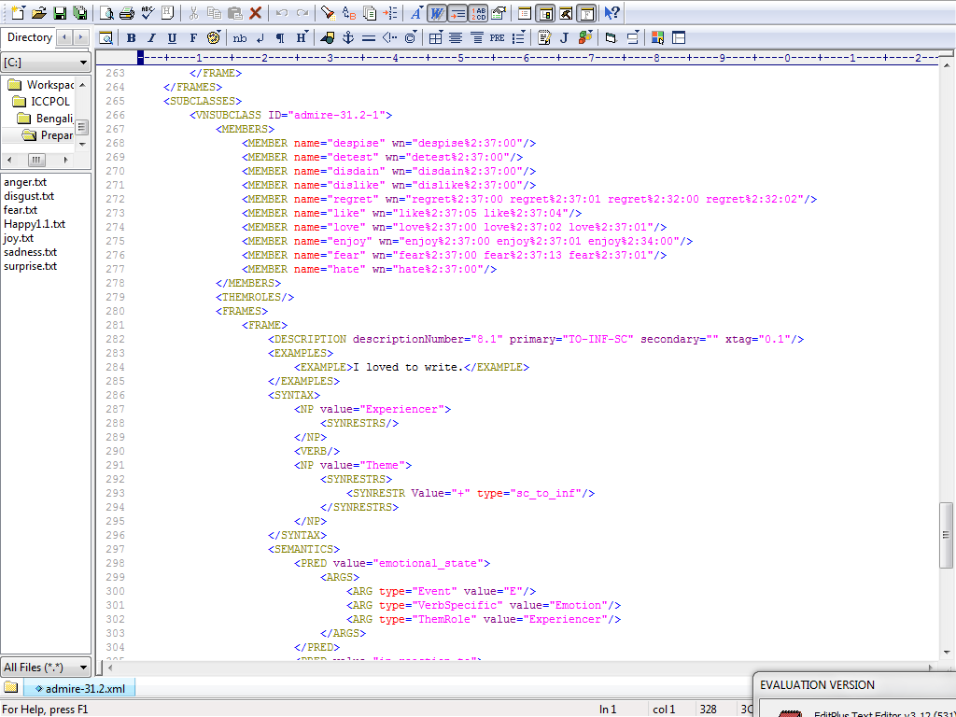
VerbNet
Snapshot

Slide 60
Holder Identification
Syntactic System (Method – B)
POS tagged and chunked data.
Stanford Maximum Entropy based POS tagger (Manning, 2000) and a Conditional Random Field (CRF) based chunker (Phan, 2006)
Component of the chunk is marked with beginning or intermediate or end
The POS of the beginning part of every chunk to construct the argument structure of the sentence corresponding to the emotional verb
Fails to disambiguate the arguments from the adjuncts
Sentence : I love them
Chunked Output : I/PRP/B-NP love/VBP/B-VP them/PRP/B-NP ././O
Acquired Argument Structure: [NP VP NP]
Simplified Extracted VerbNet Frame Syntax: [<NP value="Experiencer” ></VERB><NPtheme>]

Slide 61
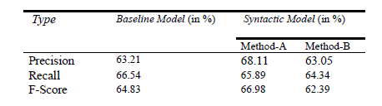
Holder Identification
Evaluation
Table 2: Results of Baseline and Syntactic Systems

Slide 62
Holder Identification
Publications (Conference)
- D.Das and S.Bandyopadhyay. 2010. Emotion Holder for Emotional Verbs – The role of Subject and Syntax. In the proceedings of 11th International Conference on Intelligent Text Processing and Computational Linguistics, (CICLing- 2010), A. Gelbukh (Ed.), LNCS 6008, pp. 385-393, Romania
- D. Das and S. Bandyopadhyay. 2010. Finding Emotion Holder from Bengali Blog Texts –An Unsupervised Syntactic Approach. Student Session. 24th Pacific Asia Conference on Language, Information and Computation (PACLIC 2010), November 4-7, Sendai, Japan.

Slide 63
Emotion/Sentiment Triangle
Expression
Holder
Topic

Slide 64
Salient Roadmap
Evaluative Expressions (word/phrase/sentence/document level)
Holder Identification
Topic Detection

Slide 65
Topic Detection
(Stoyanov and Cardie, 2008)
“topic is the real world object, event, or abstract entity that is the primary subject of the opinion as intended by its holder”
Ex1:
“He first cried up the toy car”
Ex2:
“Max ignored the issues of sports as well as politics”

Slide 66
Topic Detection
Target Span (Stoyanov and Cardie, 2008)
- Text span covering syntactic surface form
- Comprising contents of emotion or opinion
“He first cried up the toy car”
“Max ignored the issues of sports as well as politics”
Topic Span (Stoyanov and Cardie, 2008)
- Closest minimal span of text
- Part of Target Span
- Associated with emotional expression
“He first cried up the toy car”
“Max ignored the issues of sports as well as politics”
Notes:
Te

Slide 67
Objective
Identify
Focused Target span in text
Emotion Topics and associated spans from focused Target span
Multiple emotion topics (if present) from focused Target span

Slide 68
Baseline System
Object information of parsed dependency relations
(Stanford Parser, Marneffe de Marie-Catherine et al., 2006)
“He first cried up the toy car”
Dependency Relations: nsubj(cry-3, He-1), advmod(cry-3, first-2), prt(cry-3, up-4), det(car-7, the-5), nn(car-7, toy-6), dobj(cry-3, car-7)
“Problem in lexical scopes of topics”

Slide 69
Baseline System [+Syntactic]
Verb based syntactic argument structure or subcategorization frame
VerbNet (Kipper-Schuler, 2004)
- Combines lexical semantic information i.e Thematic Roles, semantic predicates, syntactic frames and selectional restrictions
Extract
- Syntactic frames with topic related thematic information (e.g. Topic, Theme, Event etc.) from VerbNet XMLs
Extracted VerbNet Frame Syntax:
[<NP value="Agent” ></VERB><NP-topic>]

Slide 70
Baseline System [+Syntactic]
Acquire
- Phrasal Argument Structure from head parts of the parsed sentences
Parse Tree: (ROOT (S (NP (PRP He))(ADVP (RB first))(VP (VBD cried)(PRT (RP up)) (NP (DT the)(NN toy)(NN car)))(. .)))
Acquired Argument Structure: [NP VP NP]
Match
- Any extracted VerbNet syntactic frame with acquired argument structure
- Tag topic in appropriate slot in the acquired argument structure
Extracted VerbNet Frame Syntax:
[<NP value="Agent” ></VERB><NP-topic>]
Acquired Argument Structure:
[NP VP NP]

Slide 71
VerbNet
Snapshot

Slide 72
Baseline System [+Syntactic]
Table 2: Improvement of Baseline System with Syntactic knowledge

Slide 73
Errors in Baseline [+Syntactic]
Identifies emotion topic mostly from sentences containing single topic
Problems remain in
- Unstructured sentences (e.g. “Really starting to lose it.”)
- Typographic errors (e.g. “she's feeling very goooood about herself.”)
- Separating emotion topics from non-emotion topics
- Selecting lexical scopes of topic spans
- Handling passive sentences

Slide 74
Hybrid System
Distribution of topics in target span of writer’s text
- Identifying target span using Rhetorical Structure
“The topic of an opinion depends on the context in which its associated opinion expression occurs” (V. Stoyanov, and C. Cardie)
- Identifying emotion topic span using Heuristic Classification

Slide 75
Rhetorical Structure Extraction
Rhetorical elements, locus, {nucleus} and [satellite] from a sentence (Mann and Thompson, 1988)
Primary goal of the writer, termed as nucleus
Other part that provides supplementary material, termed as satellite
locus, the main effective part of nucleus or satellite
“{I enjoyed the summer vacation} [because I had a golden chance to play cricket in that period]”

Slide 76
Rhetorical Structure Extraction
Assumption
- locus occurs as emotional expression (word/phrase)
- Word found in WordNet Affect (C. Strapparava and A. Valitutti) is referenced as locus
- locus may be present in nucleus or satellite
Primary Target Span
- Text span containing both nucleus and satellite except locus

Slide 77
Rhetorical Structure Extraction
nucleus and satellite
Clues are useful if explicitly specified in text
- Punctuation markers (,) (!) (?)
- Causal keywords (32 keywords as, because, that, while, whether etc.)
- Explicit Discourse Markers [Component of conjunctive_() / mark_()
dependency relations, conj_and (), conj_or(), conj_but() ]
- Causal verbs to identify the nucleus
Total 250 Causal verbs from XML files of VerbNet if any file contains any frame with semantic type “Cause”
“{They cause tears to run down my cheeks} [that in turn make me want to fall to my knees.]”
A separate research area

Slide 78
Rhetorical Structure Extraction
Primary target span contains Emotion Holder (Das and Bandyopadhyay, 2010)
Primary target span with nucleus and satellite except locus and holder
→ Maximum Target Span (Max_TS)
“Max ignored (the issues of sports as well as politics)”
Maximum Target Span (Max_TS) → Maximum Focused Target Span (Max_FTS) → Topic spans contain less adjunct components
Direct or Transitive dependency relations
- Words that are related to the locus and holder through direct or transitive dependency relations are part of the Maximum Focused Target Span

Slide 79
Heuristic Classifier
Topic spans may contain string of words/phrase of Max_FTS
→ require chunking
Open source Stanford Maximum Entropy based POS tagger (Marneffe Marie-Catherine de et al., 2006)
Conditional Random Field (CRF) based chunker (Phan, 2006)
Assign a heuristic score (Hscore) to each of the chunked phrases of Max_FTS
l = number of features identified for a chunked phrase,
Hscore = ∑ (Fetscore * l)
Fetscore is a fixed decimal value with respect to all features

Slide 80
Heuristic Classifier
Features (1/4)
Emotion Holder (EH):
- Any direct or transitive dependency relation between any word of a chunked phrase and emotion holder identifies the topic span
nsubj(cry-3, He-1), dobj(cry-3, car-7), nn(car-7, toy-6)
Named Entity (NE):
- Any word of a chunked phrase in Max_FTS is a named entity
- Stanford Named Entity Recognizer (http://nlp.stanford.edu/software/CRF-NER.shtml)
“I forgot how demeaning BME classes are.”

Slide 81
Heuristic Classifier
Features (2/4)
Structural Similarity (StrucSim): Any word of a chunked phrase and the locus
- Common similarity: co-occur in nucleus or in satellite
- Distinctive similarity: occur separately in nucleus and satellite (Fetscore = zero)
“{I enjoyed the summer vacation}[…]” → “{I enjoyed the summer vacation}[…]”
Sentiment Similarity (SentiSim): Any word of a chunked phrase
- Present in the SentiWordNet (Esuli Andrea, and Fabrizio Sebastiani, 2006)
- positive or negative valence from SentiWordNet
- Either positive or negative sentiment score (> 0.0), an extra feature score (Fetscore)
“overall it was a pretty good tournament”

Slide 82
Heuristic Classifier
Features (3/4)
Semantic Similarity (SemSim):
WordNet features identified between any word of a chunked phrase and the locus
- WordNet Synonymy: Word of Max_FTS and locus present in any synset of WordNet
“I won the financial profit.”
- WordNet Hypernymy: Word of Max_FTS is defined as event, topic, theme, subject, issue or matter in its hypernym tree
“you at least suffered the circumstances”

Slide 83
Heuristic Classifier
Features (4/4)
Semantic Similarity (SemSim):
- WordNet SenseID: Word and the locus both share at least a common SenseID
“He can enjoy his love with freedom.”
Syntactic Similarity (SynSim):
- POS based argument structure present between the phrase and locus
- Consider the chunked phrases containing verb, noun and preposition
- Phrase is already tagged as a theme or topic or event by the baseline system
“He first cried up the toy car”

Slide 84
Evaluation
Select chunks as topics with a threshold Hscore (>.5)
Two Strategies:
[H1] : Select the chunked phrase with best heuristic score (Hscore)
[H2] : Slightly Relaxed Selection
- Considering the chunked phrases with next highest heuristic scores (Hscore)
- Performance Improved
Table : Results of Unsupervised Hybrid System with Hscores

Slide 85
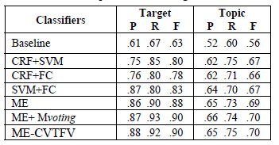
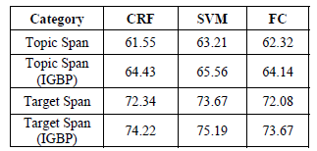
Topic Detection
Supervised Framework
Classification (SVM, CRF, Fuzzy)
- Feature Analysis
- Information Gain Based Pruning
Multi-Engine with Voting
- Majority Voting (Mvoting)
- Cross Validation Total F-Score Values (CVTFV)

Slide 86
Topic Detection
Attempts
- D. Das and S. Bandyopadhyay. 2010. Identifying Emotion Topic - An Unsupervised Hybrid Approach with Rhetorical Structure and Heuristic Classifier. In the proceedings of the 6th International Conference on Natural Language Processing and Knowledge Engineering (IEEE NLP-KE 2010), August 21-23, Beijing, China.
- D. Das and S. Bandyopadhyay. 2010. Extracting Emotion Topics from Blog Sentences – Use of Voting from Multi-Engine Supervised Classifiers. 2nd International Workshop on Search and Mining User-generated Contents (SMUC 2010) of 19th ACM International Conference on Information and Knowledge Management (CIKM 2010), October 30, Toronto, Canada

Slide 87
Emotion/Sentiment Triangle
Expression
Holder
Topic

Slide 88
Holder – Topic
Holder and Topic are emotion coreferent or not?
Features for SVM framework
- Lexical (POS, Negation, Conjuncts, Punctuation Symbols (!, @), emoticons ( ☺, ☹, 😐 )
- Syntactic (Components of argument structure or frames )
- Semantic (Affect Word, Intensifier, Multi Word Expressions)
- Rhetoric (Common and Distinctive similarities)
- Overlapping (Word, POS, Named Entity, NP coreference)
Information Gain Based Pruning (IGBP)
Evaluation using Corefence Measure
- Passonneau’s (2004) generalization of Krippendorff’s (1980) α, standard metric employed for inter-annotator reliability studies

Slide 89
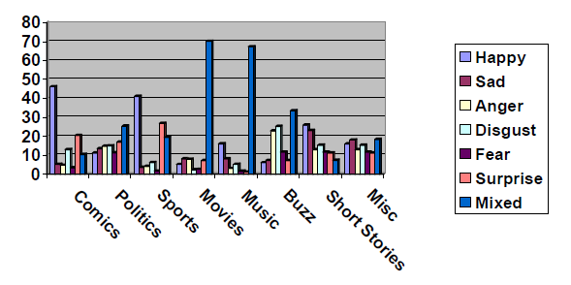
Holder – Topic
Users’ different emotions on different topics
Single topic corefered by several users / multiple topics coreferred by single user
This hypothesis aims to generate many to many correspondence among the blog users and topics
The Ekman’s six different emotions are plotted for 8 different topics referred by each of the 22 bloggers

Slide 90

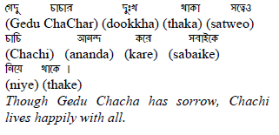
Holder – Topic
Case 1. Appositive Use :
Case 2. Co reference with Emotional Expression:
Case 3. Multiple Holders and Topics
Removing inflectional
suffix (-এর –er etc.)
NOT
Immediate neighboring
chunks of the identified
emotional expressions
/ co referred chunks
containing holders or topics
The chunks identified by the
syntactic system as holder and
topic and tagged as
common rhetoric similarity

Slide 91
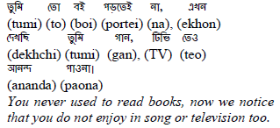


Holder – Topic
Case 4. Overlapping Topic Spans
Case 5. Anaphoric Presence of Holders
The chunks identified by the
syntactic system as topic and
tagged as common rhetoric
similarity
If a pronoun is present
with an emotional
expression in a chunk,
Consider the preceding
Named Entities of
the phrasal pattern

Slide 92
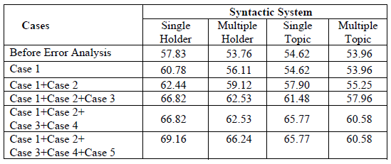
Holder – Topic
Results of the syntactic system after error handling

Slide 93
Holder – Topic
Attempts
- D. Das and S. Bandyopadhyay. 2010. Discerning Emotions of Bloggers based on Topics – a Supervised Coreference Approach in Bengali. In the proceedings of the 22nd Conference on Computational Linguistics and Speech Processing (ROCLING 2010), pp. 350-360, Puli, Nantou, Taiwan.
- D. Das and S. Bandyopadhyay. 2010. Identifying Emotion Holder and Topic from Bengali Emotional Sentences. In the proceedings of the 8th International Conference on Natural Language Processing (ICON 2010), pp. 117-126, IIT Kharagpur, India.
- D. Das and S. Bandyopadhyay. 2011. Emotions on Bengali Blog Texts: Role of Holder and Topic. First Workshop on Social Network Analysis in Applications (SNAA 2011), 2011 International Conference on Advances in Social Networks Analysis and Mining (ASONAM 2011) (Accepted)

Slide 94
Emotion/Sentiment Triangle
Expression
Holder
Topic

Slide 95
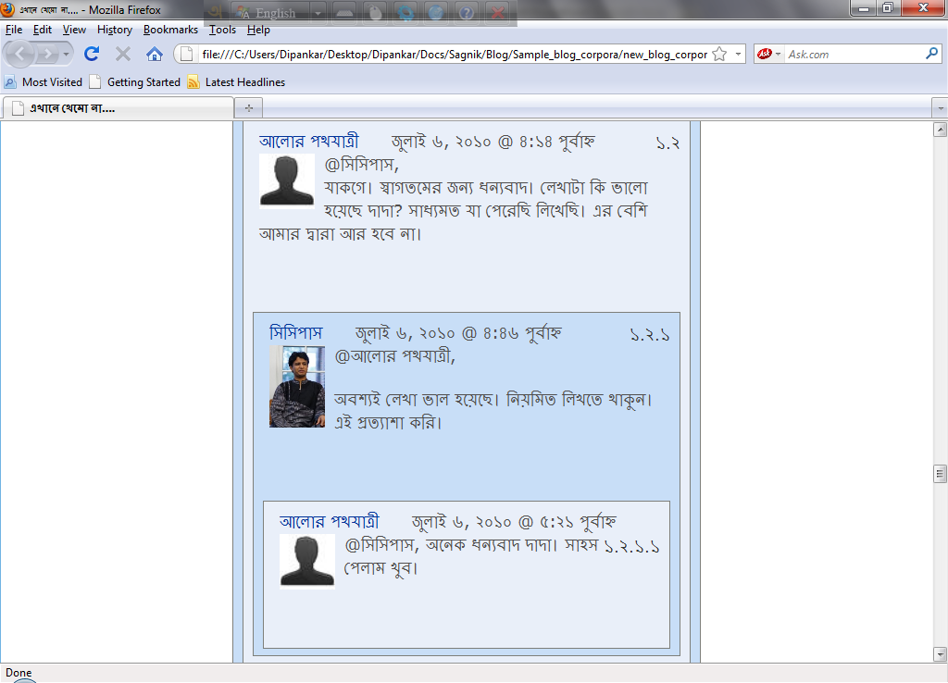
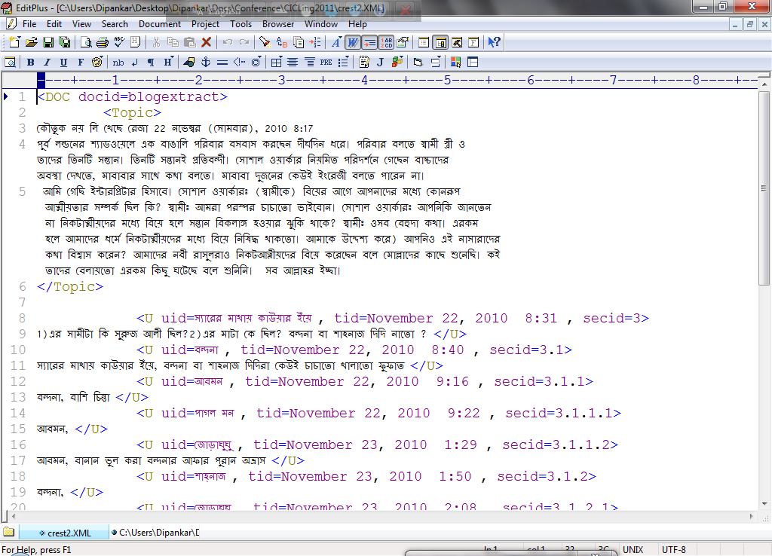
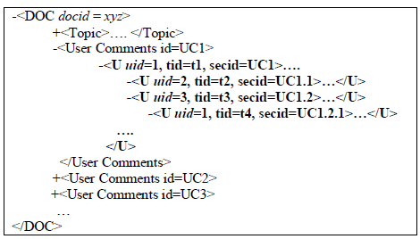
Em☺ti☹n Tracking
- of Bl😐ggers (Holder specific)
General Structure of a Bengali blog document

Slide 96

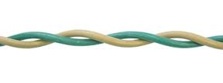
Em☺ti☹n Tracking
- of Events (Topic Specific)
Sentiment Tracking on TempEval 2007 , Task C
- Temporal Relations (AFTER, BEFORE and OVERLAP) between verb events in adjacent sentences
Sentiment Twist : Sentiment change between two consecutive events
Sentiment Transition : Sentiment change between two non-consecutive events (An event chain with several intermediate events related by Temporal Relations)

Slide 97
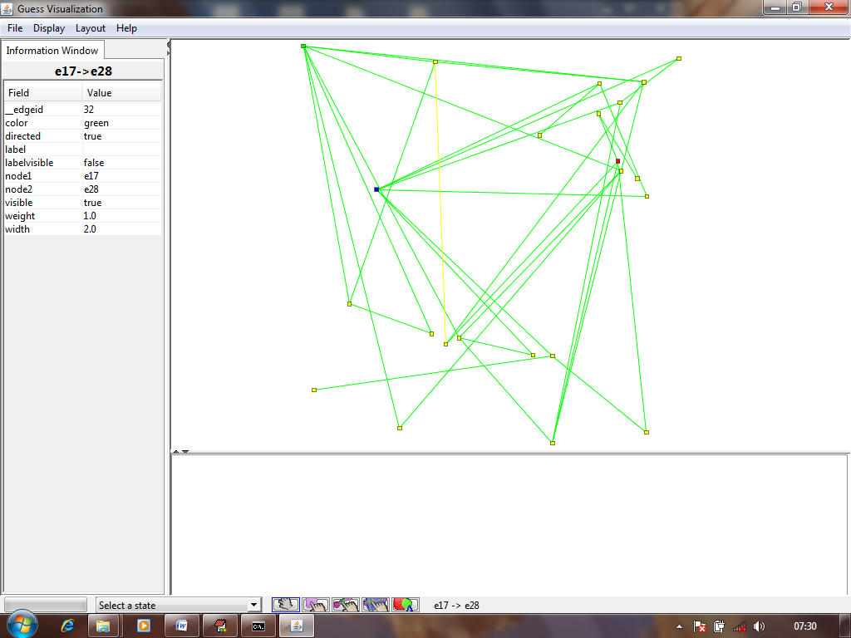
Visualization
+Ve Sentiment Hub
e17 +Ve
-Ve Sentiment Hub
<e28, e17> AFTER
Sentiment Twist
+Ve → -Ve
e28 -Ve

Slide 98
Visualization
+Ve Sentiment Hub
e17 +Ve
e23 -Ve
-Ve Sentiment Hub
<e28, e17> AFTER
<e28, e23> BEFORE
Sentiment Transition
+Ve → –Ve → –Ve
e28 -Ve

Slide 99
Emotion Tracking
Attempts
- D. Das, A. Kolya, A. Ekbal and S. Bandyopadhyay. 2011. Temporal Analysis of Sentiment Events – A Visual Realization and Tracking. In the proceedings of 12th International Conference on Intelligent Text Processing and Computational Linguistics, (CICLing- 2011), A. Gelbukh (Ed.), LNCS 6608, pp. 417-428, Tokyo, Japan.
- D.Das and S.Bandyopadhyay. 2011. Tracking Emotions of Bloggers – A Case Study for Bengali. POLIBITS, Research journal on Computer science and computer engineering with applications, ISSN 1870-9044 (Accepted)

Slide 100
Conclusion
Identifying three salient vertices of the Emotion Triangle
Methodologies (Rule based and Machine Learning)
Handling of metaphors, idioms
Emotion Document Retrieval
Domain Adaptation
Language Independence
- Based on English resources

Slide 101
Resources - Lexicons
Wordnet-Affect
  http://wndomains.itc.it/download.html
  http://www.cse.unt.edu/~rada/affectivetext/
SentiWordNet
  http://sentiwordnet.isti.cnr.it/
ConceptNet
  http://web.media.mit.edu/~hugo/conceptnet/
CYC
  http://www.cyc.com
Mindnet
  http://research.microsoft.com/nlp/projects/mindnet.aspx
General Inquirer
  http://www.wjh.harvard.edu/~inquirer

Slide 102
Resources - Corpus
SemEval 2007
  http://www.cse.unt.edu/~rada/affectivetext/
FWF Corpus
  http://www.cogs/susx.ac.uk/users/jlr24/data/fwf-corpus.zip
Blog Corpus (Available on Request)
  http://www.site.uottawa.ca/~szpak/#rsch

Slide 103
Methodologies
WordNet Affect for Proposed Target Languages
  WordNet
  English to Indian Language (E-IL) Bilingual Dictionary
  Translation
SemEval 2007 Emotion Corpus
- Translation using google API (http://translate.google.com/#)
Morphological Analyzer
- Stemmer

Slide 104
References
Ekman, P. 1992. An Argument for Basic Emotions.Cognition and Emotion, vol. 6, pp.169–200
Ku Lun-Wei, Yu-Ting Liang, and Hsin-Hsi Chen. 2006. Opinion extraction, summarization and tracking in news and blog corpora. AAAI-2006, pp. 100-107
Janyce Wiebe, Theresa Wilson, and Claire Cardie. 2005. Annotating expressions of opinions and emotions in language. Language Resources and Evaluation (formerly Computers and the Humanities), 39(2-3), pp. 165--210
Quan Changqin and Fuji Ren. 2009. Construction of a Blog Emotion Corpus for Chinese Emotional Expression Analysis. Empirical Method in Natural Language Processing- Association for Computational Linguistics, pp. 1446-1454, Singapore
Zhang Yu, Li Zhuoming, Ren Fuji and Kuroiwa Shingo. 2008. A preliminary research of Chinese emotion classification model. IJCSNS, 8(11),127-132
Quirk, R., Greenbaum, S., Leech, G., Svartvik, J. 1985. A Comprehensive Grammar of the English Language. Longman, New York
Polanyi L. and A. Zaenen. 2004. Contextual valence shifters. Computing Attitude and Affect in Text: Theory and Applications, In J. Shanahan, Y. Qu, and J. Wiebe (eds.), vol. 20, pp. 1–9
Changhua Yang Kevin Hsin-Yih Lin Hsin-Hsi Chen. 2009. Writer Meets Reader: Emotion Analysis of Social Media from both the Writer's and Reader's Perspectives. 009 IEEE/WIC/ACM International Joint Conference on Web Intelligence and Intelligent Agent Technology, pp.287-290
Miller George A., “WordNet: An on-line lexical database”, International Journal of Lexicography”, vol. 3(4), pp. 235–312, 1990.
Carlo Strapparava, A. Valitutti, “Wordnet-affect: an affective extension of wordnet,” In 4th International Conference on Language Resources and Evaluation, pp. 1083-1086, 2004.
Carlo Strapparava, A. Valitutti, O. Stock, “The affective weight of the lexicon,” In the 5th International Conference on Language Resources and Evaluation (LREC 2006), pp. 474-481, Genoa, Italy, 2006.
Esuli Andrea, and Fabrizio Sebastiani, “SENTIWORDNET: A Publicly Available Lexical Resource for Opinion Mining”, LREC-06, 2006.

Slide 105
References
Carmen Banea, Rada Mihalcea, Janyce Wiebe., “A Bootstrapping Method for Building Subjectivity Lexicons for Languages with Scarce Resources,” The Sixth International Conference on Language Resources and Evaluation (LREC 2008), 2008.
Kipper-Schuler K., “VerbNet: A broad-coverage, comprehensive verb lexicon”. Ph.D. thesis, Computer and Information Science Dept., University of Pennsylvania, Philadelphia, PA, 2004
Cohen, J. 1960. A coefficient of agreement for nominal scales. Educational and Psychological Measurement, vol. 20, pp. 37–46.
Passonneau, R.J. 2006. Measuring agreement on set-valued items (MASI) for semantic and pragmatic annotation. Language Resources and Evaluation.
Wiebe Janyce, Theresa Wilson, and Claire Cardie. 2005. Annotating expressions of opinions and emotions in language. Language Resources and Evaluation, vol. 39, pp.164–210.
Manning Christopher D., and Kristina Toutanova, “Enriching the Knowledge Sources Used in a Maximum Entropy Part-of-Speech Tagger”, SIGDAT Conference on Empirical Methods (EMNLP/VLC), 2000
Phan Xuan-Hieu., “CRFChunker: CRF English Phrase Chunker”, PACLIC, 2006.
Stoyanov, V., and C. Cardie, “Annotating topics of opinions”, In Proceedings of LREC, 2008.
Stoyanov V., and C. Cardie, “Topic Identification for Fine-Grained Opinion Analysis”, Coling 2008, pp. 817–824, 2008.
Mann, W. C., and S. A. Thompson, “Rhetorical Structure Theory: Toward a Functional Theory of Text Organization”, TEXT 8, pp. 243–281, 1988.
Marneffe Marie-Catherine de, Bill MacCartney, and Christopher D.Manning., “Generating Typed Dependency Parses from Phrase Structure Parses”, 5th International Conference on Language Resources and Evaluation, 2006.
Carlo Strapparava, Rada Mihalcea .SemEval-2007 Task 14: Affective Text.Proceedings of the 45th Aunual Meeting of Association for Computational linguistics, 2007.

Slide 106
Thank You

