Slide 1
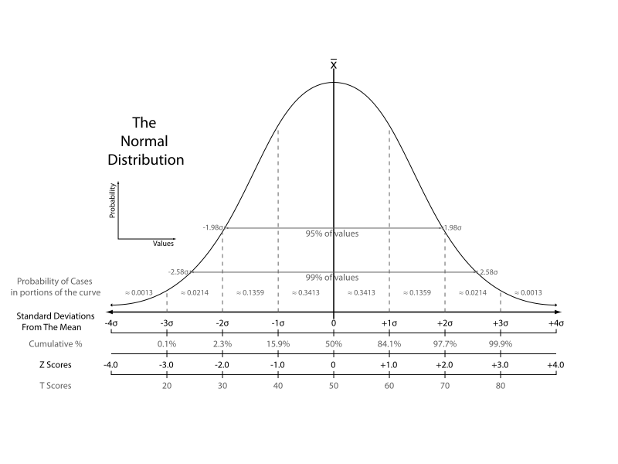
Chomsky’s Spell Checker
Cohan Sujay Carlos, Aiaioo Labs, Bangalore

Slide 2
How would you build a spell checker for Chomsky?
Use spelling rules to correct spelling?
Use statistics and probabilities?

Slide 3
Chomsky
Derided
researchers in machine learning
who use purely statistical methods
to produce behaviour that mimics something in the world,
but who don't try to understand the meaning of that behaviour.

Slide 4
Chomsky
Compared
such researchers
to scientists
who might study the dance made by a bee returning to the hive,
and who could produce a statistically based simulation of such a dance
without attempting to understand why the bee behaved that way.

Slide 5
So, don’t misread Chomsky
As you can see:
Chomsky has a problem with
Machine Learning
in particular with what some users of machine learning do not do …
but no problem with
Statistics.

Slide 6
Uses of Statistics in Linguistics
How can statistics be useful?
Can probabilities be useful?

Slide 7
Statistical <> Probabilistic
Statistical:
Get an estimate of a parameter value
Show that it is significant
F = G m₁ m₂ / r²
Used in establishing
the validity of experiment claims

Slide 8
Statistical <> Probabilistic
Probabilistic:
Assign probabilities to the outcomes of an experiment
Linguistics: outcome = category

Slide 9
Linguistic categories can be uncertain
Say you have two categories:
1. (Sentences that try to make you act)
2. (Sentences that supply information)
“Buy an Apply iPod” is of category 1.
“An iPod costs $400” is of category 2.
Good so far … but …
“I recommend an Apply iPod” is what?
Maybe a bit of both?

Slide 10
What is a Probability?
A number between 0 and 1
Sum of the probabilities on all outcomes must be 1

Slide 11
What is a Probability?
A number between 0 and 1 assigned to an outcome such that …
The sum of the probabilities on all outcomes is 1
O = heads
O = tails
P(heads) = 0.5
P(tails) = 0.5

Slide 12
Categorization Problem : Spelling
Field
Wield
Shield
Deceive
Receive
Ceiling

Slide 13
Rule-based Approach
“I before E except after C”
-- an example of a linguistic insight

Slide 14
Probabilistic Statistical Model:
Count the occurrences of ‘ie’ and ‘ei’ and ‘cie’ and ‘cei’ in a large corpus
P(IE) = 0.0177
P(EI) = 0.0046
P(CIE) = 0.0014
P(CEI) = 0.0005

Slide 15
Words where ie occur after c
science
society
ancient
species

Slide 16
Courtesy Peter Norvig’s article on Chomsky
http://norvig.com/chomsky.html

Slide 17
Chomsky
In 1969 he wrote:
But it must be recognized that the notion of "probability of a sentence" is an entirely useless one, under any known interpretation of this term.

Slide 18
Chomsky’s Argument
A completely new sentence must have a probability of 0, since it is an outcome that has not been seen.
Since novel sentences are in fact generated all the time, there is a contradiction.

Slide 19
Probabilistic language model
Probabilities should broadly indicate likelihood of sentences
P(I saw a van) >> P(eyes awe of an)
Courtesy Dan Klein

Slide 20
AXIOMS of Probability
Let’s start!
Definitions
Outcome
Sample Space S
Event E
Axioms of Probability
Axiom 1: 0 <= P(E) <= 1
Axiom 2: P(S) = 1
Axiom 3: P(union [ E ]) = sum[ P(E) ]
for mutually exclusive events.

Slide 21
CONDITIONAL PROBABILITY
P(EF) = P(E|F) * P(F)
Example: Tossing 2 coins
Coin 1 E | Coin 2 F | P(EF)
0 (tails) | 0 (tails) | 0.25
0 (tails) | 1 (heads) | 0.25
1 (heads) | 0 (tails) | 0.25
1 (heads) | 1 (heads) | 0.25
This is a table of P(EF). You find that no matter what E or F is, P(EF)=0.25

Slide 22
MARGINAL PROBABILITIES
From the previous table you can calculate that …
E | P(E)
0 | 0.5
1 | 0.5
F | P(F)
0 | 0.5
1 | 0.5

Slide 23
CONDITIONAL PROBABILITY
P(EF) = P(E|F) * P(F)
So, now, applying the above equation …
Coin 1 E | Coin 2 F | P(E|F)
0 (tails) | 0 (tails) | 0.5
0 (tails) | 1 (heads) | 0.5
1 (heads) | 0 (tails) | 0.5
1 (heads) | 1 (heads) | 0.5
You see that in all cases, P(E|F) = P(E). This means E and F are independent.

Slide 24
CONDITIONAL PROBABILITY
P(DEF) = P(D|EF) * P(EF)
This is very similar to P(EF) = P(E|F) * P(F)
I’ve just replaced E with D,
And F with EF.

Slide 25
CONDITIONAL PROBABILITY
P(DEF) = P(D|EF) * [ P(E|F) * P(F) ]
P(EF)
Using P(EF) = P(E|F) * P(F)

Slide 26
CONDITIONAL PROBABILITY
P(DEF) = P(D|EF) * P(E|F) * P(F)
P(“I am human”) =
P(“human” | “I am”) * P(“am” | “I”) * P(“I”)

Slide 27
CONDITIONAL PROBABILITY
P(DEF) = P(D|EF) * P(E|F) * P(F)
P(“I am human”) =
P(“human” | “I am”) * P(“am” | “I”) * P(“I”)
P(“I am human”) =
C(“I am human”)/C(“I am”)
* C(“I am”)/C(“I”)
* C(“I”)/C(“*”)

Slide 28
Markov Assumption
You can’t remember too much.

Slide 29
CONDITIONAL PROBABILITY
P(DEF) = P(D|EF) * P(E|F) * P(F)
P(“I am human”) =
P(“human” | “I am”) * P(“am” | “I”) * P(“I”)
P(“I am human”) =
C(“I am human”)/C(“I am”)
* C(“I am”)/C(“I”)
* C(“I”)/C(“*”)
So, you ‘forget’ the green stuff.

Slide 30
CONDITIONAL PROBABILITY
P(DEF) = P(D|EF) * P(E|F) * P(F)
P(“I am human”) =
P(“human” | “am”) * P(“am” | “I”) * P(“I”)
P(“I am human”) =
C(“am human”)/C(“am”)
* C(“I am”)/C(“I”)
* C(“I”)/C(“*”)
Now this forgetful model can deal with unknown sentences.
I’ll give you one.

Slide 31
UNKNOWN SENTENCE
I never heard anyone say this before!
I am 6 ft and some.
It’s a hitherto unknown sentence!
P(“Cohan is short”)
=
P(“short” | “is”) * P(“is” | “Cohan”) * P(“Cohan”)
=
C(“is short”)/C(“is”)
* C(“Cohan is”)/C(“Cohan”)
* C(“Cohan”)/C(“*”)

Slide 32
Solved!
But there’s another way to solve it …
and you’ll see how this has a lot to do with spell checking!

Slide 33
Spell Checking
Let’s say the word hand is mistyped
Hand --- *Hamd
There you have an unknown word!

Slide 34
Spell Checking
Out-of-Vocabulary Error
*Hamd

Slide 35
Spell Checking
*Hamd
Hand

Slide 36
Spell Checking
*Hamd
Hand
Hard

Slide 37
What we need to find …
P(hard|hamd)
P(hand|hamd)
Whichever is greater is the right one!

Slide 38
What we need to find …
But how do you find the probability P(hard|hamd) when ‘hamd’ is an *unknown word*?
This is related to Chomsky’s conundrum of the unknown sentence, isn’t it?
The second approach uses a little additional probability theory.

Slide 39
BAYES RULE
Conditional Prob:
P(FE) = P( F|E ) * P (E)
P(EF) = P( E|F ) * P (F)
P(E|F) = P(F|E) * P(E) / P(F)

Slide 40
BAYES RULE
P(E|F) = P(F|E) * P(E) / P(F)
P(hand|hamd) = P(hamd|hand)*P(hand)

Slide 41
BAYES RULE
P(E|F) = P(F|E) * P(E) / P(F)
P(hand|hamd) = P(hamd|hand)*P(hand)
P(hamd|hand) = P(h|h)P(a|a)P(m|n)P(d|d)

Slide 42
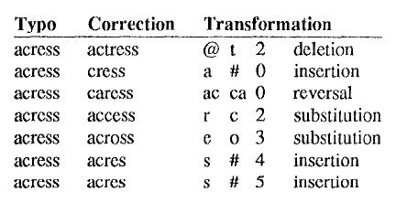
Kernighan’s paper on spell correction 1990

Slide 43
BAYES RULE
P(E|F) = P(F|E) * P(E) / P(F)
P(hand|hamd) = P(hamd|hand)*P(hand)
P(hamd|hand) = P(h|h)P(a|a)P(m|n)P(d|d)
P(hand|hamd) = P(m|n)*P(hand)
The stuff in green is approximately 1, so ignore it!

Slide 44
So we have what we needed to find …
P(hard|hamd) = P(m|n)*P(hand)
P(hand|hamd) = P(m|r)*P(hard)
Whichever is greater is the right one!

Slide 45
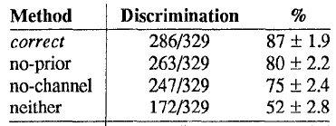
Note: Use of Unigram Probabilities
The P(m|n) part is called the channel probability
The P(hand) part is called the prior probability
Kernighan’s experiment showed that P(hand) is very important (causes a 7% improvement)!

Slide 46
Side Note: We may be able to use a dictionary with wrongly spelt words
P(hand) >> P(hazd) in the dictionary
It is possible that
P(m|n)*P(hand) > P(m|z)*P(hazd)
But more of what would have been OOV errors will now be In-Vocabulary errors.

Slide 47
Solved!
Chomsky’s Spell Checker

Slide 48
But there’s another interesting problem in Spell Checking …
When is an unknown word not an error?

Slide 49
Spell Checking
How do you tell whether an unknown word is a new word or a spelling mistake?
How can you tell “Shivaswamy” is not a wrong spelling of “Shuddering”
You can use statistics

Slide 50
Uses of Statistics
Papers
Spell-Checkers
Collocation Discovery

Slide 51
Clustering: [research paper]
Clustering Algorithm 1
o o oooooo
Clustering Algorithm 2
ooo ooo oo
The paper claims Algorithm 2 is better than Algorithm 1. Is the claim valid?

Slide 52
Clustering
Clustering Algorithm 1
o o oooooo
Clustering Algorithm 2
ooo ooo oo
Now, what do you think?

Slide 53
Purity of Clusters
Algorithm 1: 1.00
Algorithm 2: 0.55
estimates
Now, what can I make the reverse claim that Algorithm 1 is better?

Slide 54
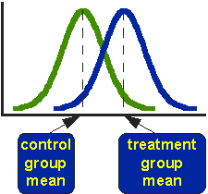
Purity of Clusters
Algorithm 1: 0.80 +- 0.2
Algorithm 2: 0.65 +- 0.3
variance
Now is the improvement because of
randomness? Or is it significant?

Slide 55
Coin Toss Experiment Analogy
O = heads
O = tails
oooo
Can I now claim that P(H) = 0.75?
Can I make the claim that I have a coin whose P(H) is 0.75 and not 0.5?

Slide 56
Check significance with a T-test
The t-test will show that
oooo
could very easily have occurred by chance on a coin with P(H) = 0.5

Slide 57
T-test
I’ll need 50 tosses to claim that P(H) = 0.75 with a 5% probability of being wrong.
Image courtesy of a website I no longer remember

Slide 58
See how Kernighan established statistical significance in his paper
significance
estimate
variance

Slide 59
T-test
You can also use the T-test in spell checking!
Image courtesy of a website I no longer remember

Slide 60
Spell Checking
How do you tell whether an unknown word is a new word or a spelling mistake?
How can you tell “Shivaswamy” is not a wrong spelling of “Shuddering”

Slide 61
T-test
Calculate the probability of “Shivaswamy” having come about by errors made on “Shuddering” … that is, 8 errors happening in 10 letters.
P(error) = 0.8
Say the average letter error rate is 0.1.
Verify using the t-test that Shivaswamy is not likely to have come about from Shuddering by a 0.1 error-per-letter process.
Use the word length (10) as n.

Slide 62
Statistical Spell Checker
So now you have a spell checker that can not only correct OOV errors
But also knows when not to do so!

Slide 63
Recap
What you have learnt in Probabilities
Axioms of Probability
Conditional and Joint Probabilities
Independence
Bayesian Inversion
Is all you will need to start reading statistical NLP papers on:
Language Models
Spell Checking
POS tagging
Machine Translation

Slide 64
That’s all about the spell checker!
Yeah, I brought in some controversial Chomsky quotes to motivate the linguistics students to sit through the lecture, but seriously, don’t you think the chances are high he uses a spell-checker like this one?

