Slide 1
N-Grams and Smoothing
Manish Shrivastava

Slide 2
Basic Idea:
Examine short sequences of words
How likely is each sequence?
“Markov Assumption” – word is affected only by its “prior local context” (last few words)

Slide 3
Possible Applications:
OCR / Voice recognition – resolve ambiguity
Spelling correction
Machine translation
Confirming the author of a newly discovered work
“Shannon game”

Slide 4
“Shannon Game”
Claude E. Shannon. “Prediction and Entropy of Printed English”, Bell System Technical Journal 30:50-64. 1951.
Predict the next word, given (n-1) previous words
Determine probability of different sequences by examining training corpus

Slide 5
Forming Equivalence Classes (Bins)
“n-gram” = sequence of n words
bigram
trigram
four-gram or quadrigram

Slide 6
Reliability vs. Discrimination
“large green ___________”
tree? mountain? frog? car?
“swallowed the large green ________”
pill? candy?

Slide 7
Reliability vs. Discrimination
larger n: more information about the context of the specific instance (greater discrimination)
smaller n: more instances in training data, better statistical estimates (more reliability)

Slide 8
Selecting an n Vocabulary (V) = 20,000 words
n | Number of bins
2 (bigrams) | 400,000,000
3 (trigrams) | 8,000,000,000,000
4 (4-grams) | 1.6 x 10¹⁷

Slide 9
Statistical Estimators
Given the observed training data …
How do you develop a model (probability distribution) to predict future events?

Slide 10
Maximum Likelihood Estimation
$P_{MLE}\left(w_{n} | w_{1}…w_{n−1}\right)=\frac{C(w_{1}…w_{n})}{C(w_{1}…w_{n−1})}$
Estimate sequence probabilities using “counts” or frequencies of sequences
Problems
Sparseness
What do you do when unknown words are seen??

Slide 11
Smoothing
Higher order n-grams perform well but suffer from data sparsity
Lower order n-grams are not reliable
Standard MLE does not work for unseen data

Slide 12
Smoothing
Laplace smoothing (add-one)
Lidstone’s law
Jeffereys-Perks law
Held-out Estimation
Cross Validation (Deleted Estimation)
Good Turing Estimation
Back-Off
Linear Interpolation
Katz Backoff
General linear Interpolation

Slide 13
Laplace Smoothing
The oldest smoothing method available
Each unseen n-gram is given a very low estimate
$P_{Lap}(w_{1}…w_{n−1}w_{n})=\frac{C\left(w_{1}…w_{n}\right)+1}{N+B}$
Probability 1/(N+B) or Frequency (estimated) N/(N+B)
N is the number of seen n-grams and B is the number of possible n-grams

Slide 14
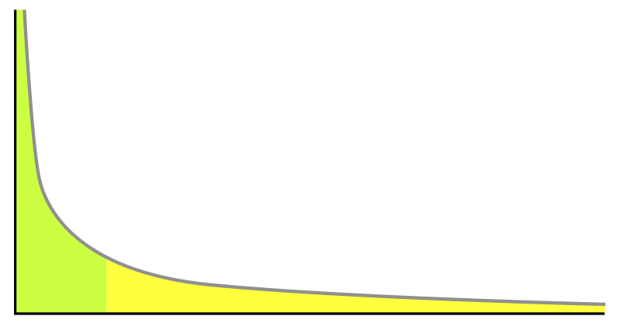
Zipf’s Law
Small number of words with very large frequency
Some words with moderate frequency
Very large number of words with very low frequency

Slide 15
Lidstone’s Law
The probability mass assigned to unseen events is too high with Laplace smoothing
Solution : assign smaller addition
$P_{Lid}\left(w_{1}…w_{n−1}w_{n}\right)=\frac{C\left(w_{1}…w_{n}\right)+λ}{N+Bλ}$
Jeffereys-Perks law
Set $λ$ as ½
Expectation of $λ$ that maximizes above equation

Slide 16
Held Out Estimation
Why do we think that the mass assigned to unseen words is too high?
Can we somehow test it empirically?
Yes
Train (get counts) from one large text and check against another “Held – Out” data
$P_{Ho}\left(w_{1}…w_{n}\right)=\frac{T_{r}}{N_{r}N}$
Where, Tr is the sum of number of times n-gram with frequency r appeared in held-out data, and Nr is the number of n-grams with frequency r in training data.
In effect, assigning the average probability of $P_{Ho}\left(w_{1}…w_{n}\right)$ to the n-gram with frequency r

Slide 17
Held-out Estimation
Probability is calculated keeping both training and held-out data in mind.
Is it the best estimate?
In this scenario?
If the role of training and held-out data is reversed ?
$P_{Ho}\left(w_{1}…w_{n}\right)=\frac{T_{r}^{01}}{N_{r}^{0}N}$
$P_{Ho}\left(w_{1}…w_{n}\right)=\frac{T_{r}^{01}}{N_{r}^{0}N}$

Slide 18
Deleted Estimation (Cross-Estimation)
Jelinek and Mercer 1985
$P_{Del}\left(w_{1}…w_{n}\right)=\frac{T_{r}^{01}+T_{r}^{10}}{{(N}_{r}^{0}{+N}_{r}^{1})N}$
Performs really well
Still a way off for low frequency events

Slide 19
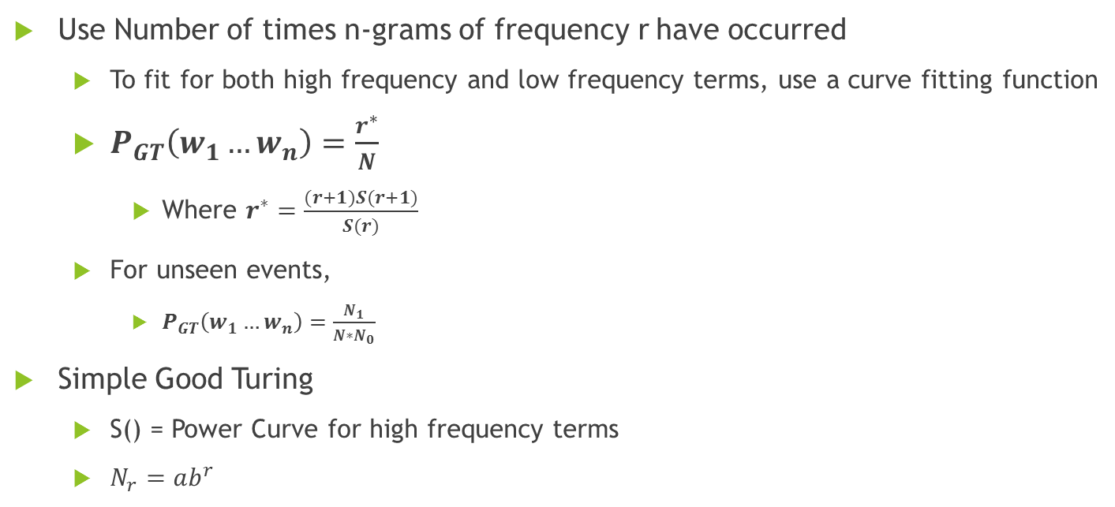
Good-Turing Smoothing
Use Number of times n-grams of frequency r have occurred
To fit for both high frequency and low frequency terms, use a curve fitting function
$P_{GT}\left(w_{1}…w_{n}\right)=\frac{r^{∗}}{N}$
Where $r^{∗}=\frac{(r+1)S(r+1)}{S(r)}$
For unseen events,
$P_{GT}\left(w_{1}…w_{n}\right)=\frac{N_{1}}{N∗N_{0}}$
Simple Good Turing
S() = Power Curve for high frequency terms
$N_{r}=ab^{r}$

Slide 20
Back off
So far, all we have done is get estimates for various n-grams
Problems (Same old),
For n-grams with low frequency, estimates are not really good
Solution,
If n-gram does not work, fall back to (n-1)-gram
Better still, combine estimators for n-gram, (n-1)-gram, (n-2)-gram … unigram

Slide 21

Linear Interpolation
$P_{li}\left(w_{n} | w_{1}…w_{n−1}\right)=λ_{1}P\left(w_{n}\right)+λ_{2}P_{li}\left(w_{n} | w_{n−1}\right)+λ_{3}P_{li}\left(w_{n} | w_{n−1},w_{n−2}\right)$
Works really well
Reserve Probability mass for unseen items
$λ_{i}$s need to be learned separately

Slide 22

Katz Back-off
$P_{li}\left(w_{n} | w_{1}…w_{n−1}\right)=α∗\frac{C(w_{1}…w_{n})}{C(w_{1}…w_{n−1})}$ if Counts are greater than a certain k
Else
$P_{li}\left(w_{n} | w_{1}…w_{n−1}\right)=(1−α)∗P_{li}\left(w_{n} | w_{2}…w_{n−1}\right)$

Slide 23
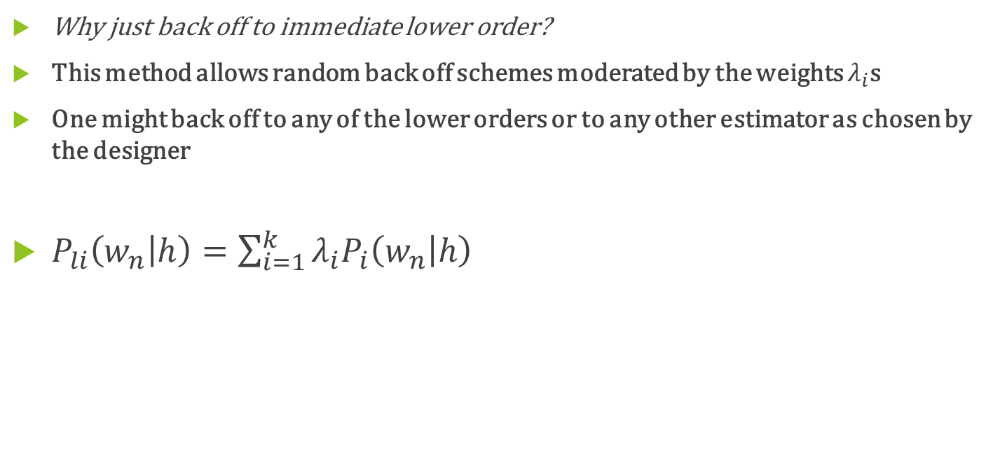
General Linear Interpolation
Why just back off to immediate lower order?
This method allows random back off schemes moderated by the weights $λ_{i}$s
One might back off to any of the lower orders or to any other estimator as chosen by the designer
$P_{li}\left(w_{n} | h\right)=\sum_{i=1}^{k}{λ_{i}P_{i}\left(w_{n} | h\right)}$

Slide 24
Questions?

