Slide 1
Introduction to Linguistics
Lecture 1
Radhika Mamidi

Slide 2
Outline
Human language
Human language features
Writing systems
Languages in contact
Language change
Language families

Slide 3
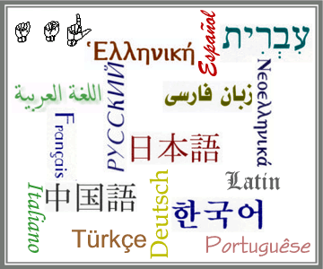
What is language?

Slide 4
It is a system of arbitrary signals, such as sounds, gestures or written symbols used for communicating thoughts, feelings, information etc.
What is language?
Is the definition complete?

Slide 5
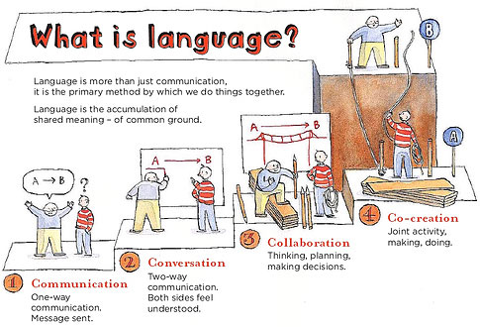

Slide 6
Origin of language
Visual signals → vocal signals [when dark]
God
Imitating birds and animals
Spontaneous singing while working

Slide 7
Human language features
Duality of patterning
Creativity
Arbitrariness
Displacement
Redundancy
Culture preserving and culture transmitting
Dynamic
Interchangeability
(Charles F Hockett, 1958;
Varma & Krishnaswamy, 1989)

Slide 8
Language and Media
Examples from Advertisements – less use of language.
Manipulate news
Striking headlines - language used creatively.

Slide 9
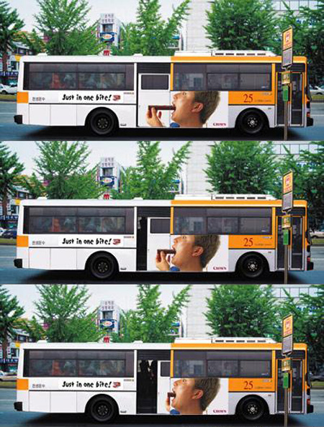

Slide 10
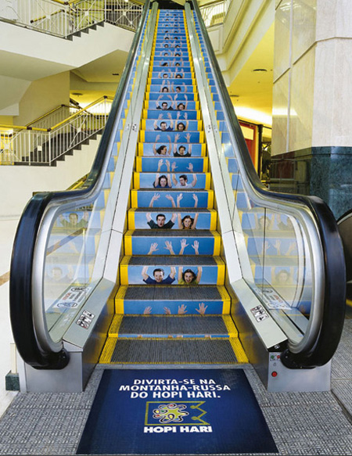

Slide 11
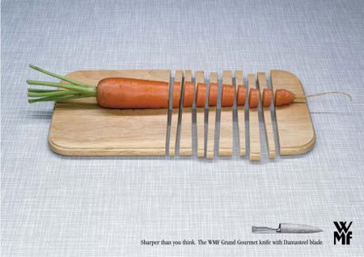



Slide 12
Writing systems
Pictographic or ideographic – each sign corresponds to an object or an idea
Logographic – each sign corresponds to a word
Syllabic - each sign corresponds to a syllabic
Alphabetic - each sign corresponds to a sound unit that makes a difference in meaning
Phonetic - each sign corresponds to a sound whether the sounds make a difference in meaning or not.

Slide 13
Varieties of language
Dialects – regional, caste, prestige
Standard dialect
Idiolect
Register, Styles
Slang, Jargon
Cant, Argot
Spoken, written varieties

Slide 14
Language families
It’s estimated there are 6,089 languages in the world grouped into language families.
Indo –European
Dravidian
Sino-Tibetan
Austric or Nishaada
Afro-Asiatic
Niger-Congo
Malaya- Polynesian
Khosian
Based on
Similarities and Difference

Slide 15
Language typologies
Typology Classification of languages based on order of verb, subject, and object in sentences.
Does not follow same groupings as families
SOV – Turkish, Japanese, Indian
SVO – English, Spanish, Russian
VSO – Irish, Scottish

Slide 16
Languages in contact
Monolingualism
Bilingualism
Pidgin
Creole
Diglossia
Code switching
Code mixing

Slide 17


English-Hindi blended naturally

Slide 18
Language change – how?
Boredom – telephone, phone, ring up, call
New realities – brunch, motel
Tendency to abridge – mike, telly, doc
Change in meaning --- villain
New meanings added – file, mouse

Slide 19
Assignment
Write about the history of your mother tongue. [1-2 pages]
Write about your knowledge of the language/s you know. [1 page]
Give 5 words to illustrate the type of changes that are taking place in your mother tongue. Comment.

Slide 20
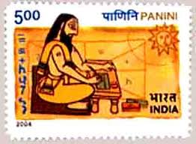
Next lecture: What is Linguistics?
It is the scientific study of human language.

Slide 21
