Slide 1
Linguistic Networks
Applications in NLP and CL
Monojit Choudhury
Microsoft Research India
monojitc@microsoft.com
color
sky
weight
light
1
blue
20
blood
100
heavy
red

Slide 2
NLP vs. Computational Linguistics
Computational Linguistics is the study of language using computers and language-using computers
NLP is an engineering discipline that seeks to improve human-human, human-machine and machine-machine(?) communication by developing appropriate systems.

Slide 3
Charting the World of NLP
Unsupervised learning
Supervised learning
Graph Theory
Data mining
Parsing
Machine Translation
Anaphora resolution
Spell-checking

Slide 4
Outline of the Talk
A broader picture of research in the merging grounds of language and computation
Complex Network Theory
Application of CNT in linguistics and NLP
Two case studies

Slide 5
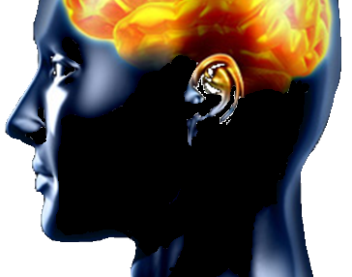
LINGUISTIC system
Representation and Processing
zulu
α
semanti
complex
bangla
network
POS
syntax
Change & Evolution
model
DD
NLP
node
edge
@
Learning
lexica
λ
ε
PA
evolution
learning
word
Perception
I speak, therefore I am.
Production

Slide 6
LINGUISTIC system
Psycholinguistics
Neurolinguistics
Representation and Processing
zulu
α
semanti
complex
bangla
network
POS
syntax
Change & Evolution
model
DD
NLP
node
edge
@
Learning
lexica
λ
ε
PA
evolution
learning
Socio/Dia. Linguistics
Games/Simulations
word
Perception
I speak, therefore I am.
Theo. Linguistics
Data Modeling
Production

Slide 7
Language is a Complex Adaptive System
Complex:
  Parts cannot explain the whole (reductionism fails)
  Emerges from the interactions of a huge number of interacting entities
Adaptive
  It is dynamic in nature (evolves)
  The evolution is in response to the environmental changes (paralinguistic and extra-linguistic factors)

Slide 8
Layers of Complexity
Linguistic Organization:
  phonology, morphology, syntax, semantics, …
Biological Organization:
  Neurons, areas, faculty of language, brain,
Social Organization:
  Individual, family, community, region, world
Temporal Organization:
  Acquisition, change, evolution

Slide 9
Layers of Complexity
Linguistic Organization:
  phonology, morphology, syntax, semantics, …
Biological Organization:
  Neurons, areas, faculty of language, brain,
Social Organization:
  Individual, family, community, region, world
Temporal Organization:
  Acquisition, change, evolution
Linguists
Physicist
Neuroscientist
Social scientist
Psychologist
Computer Scientists

Slide 10
Complex System View of Language
Emerges through interactions of entities
Microscopic view: individual’s utterances
Mesoscopic view: linguistic entities (words, phones)
Macroscopic view: language as a whole (grammar and vocabulary)

Slide 11
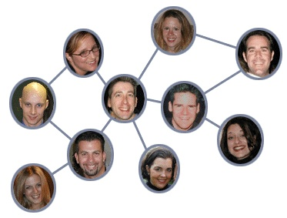
Complex Network Models
Nodes: Social entities (people, organization etc.)
Edges: Interaction/relationship between entities (Friendship, collaboration)
Courtesy: http://blogs.clickz.com

Slide 12
Linguistic Networks
color
sky
weight
light
1
blue
20
100
blood
heavy
red

Slide 13
Complex Network Theory
Handy toolbox for modeling complex systems
Marriage of Graph theory and Statistics
Complex because:
  Non-trivial topology
  Difficult to specify completely
  Usually large (in terms of nodes and edges)
Provides insight into the nature and evolution of the system being modeled

Slide 14
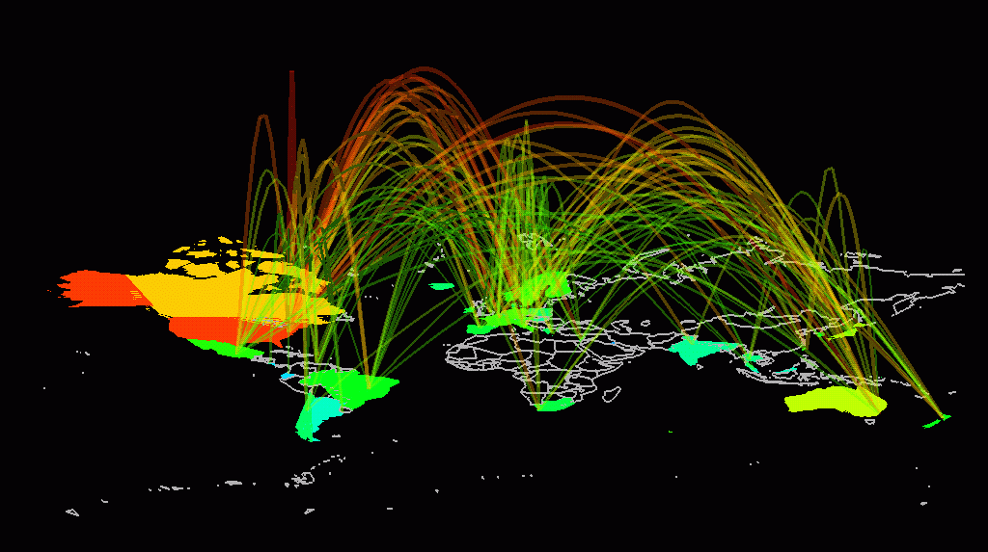
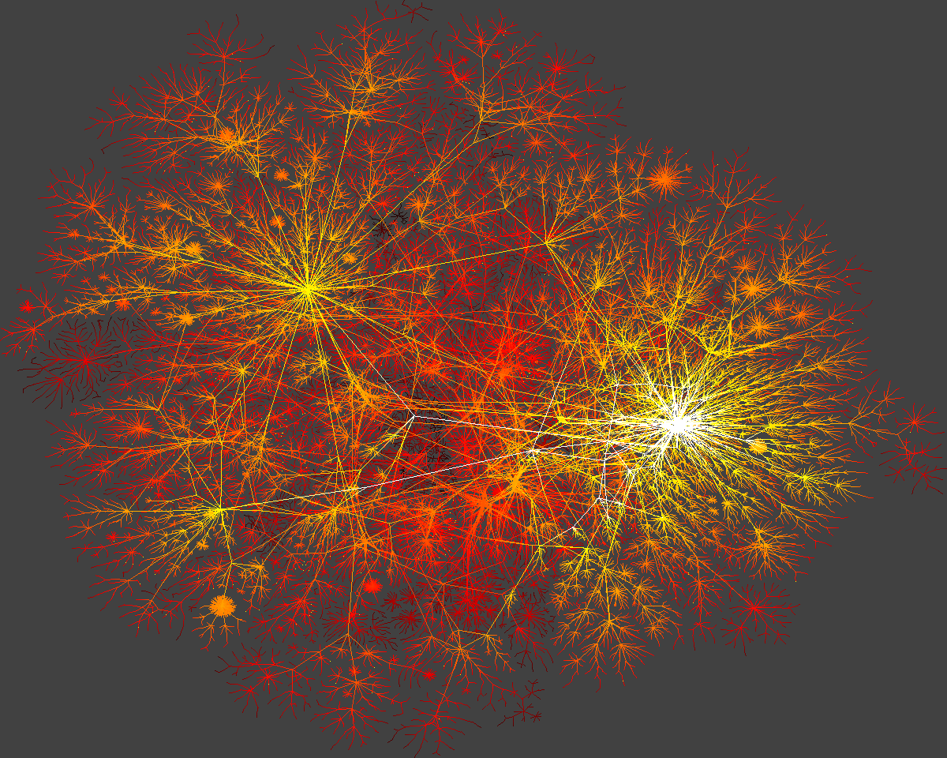
Internet

Slide 15
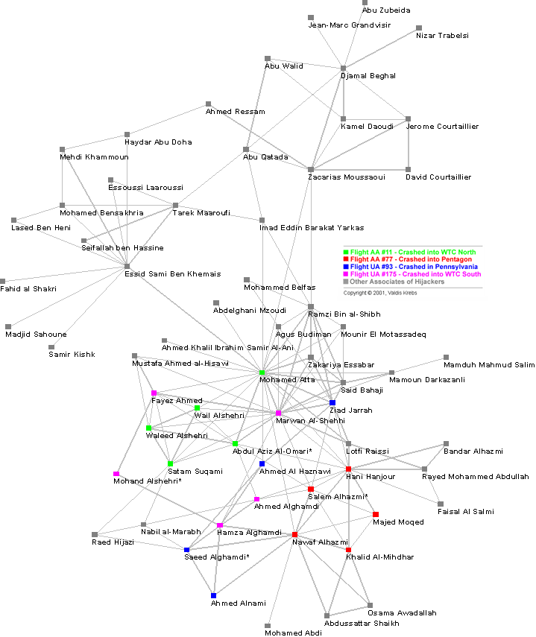
9-11 Terrorist Network
Social Network Analysis is a mathematical methodology for connecting the dots -- using science to fight terrorism. Connecting multiple pairs of dots soon reveals an emergent network of organization.

Slide 16
What Questions can be asked
Do these networks display some symmetry?
Are these networks creation of intelligent objects (by design) or have emerged (self-organized)?
How have these networks emerged:
What are the underlying simple rules leading to their complex structure?

Slide 17
Bi-directional Approach
Analysis of the real-world networks
  Global topological properties
  Community structure
  Node-level properties
Synthesis of the network by means of some simple rules
  Small-world models ……..
  Preferential attachment models

Slide 18
Application of CNT in Linguistics - I
Quantitative & Corpus linguistics
  Invariance and typology
  Properties of NL Corpora
Natural Language Processing
  Unsupervised methods for text labeling (POS tagging, NER, WSD, etc.)
  Textual similarity (automatic evaluation, document clustering)
  Evolutionary Models (NER, multi-document summarization)

Slide 19
Application of CNT in Linguistics - II
Language Evolution
  How did sound systems evolve?
  Development of syntax
Language Change
  Innovation diffusion over social networks
  Language as an evolving network
Language Acquisition
  Phonological acquisition
  Evolution of the mental lexicon of the child

Slide 20
Linguistic Networks
Name | Nodes | Edges | Why?
PhoNet | Phoneme | Co-occurrence likelihood in languages | Evolution of sound systems
WordNet | Words | Ontological relation | Host of NLP applications
Syntactic Network | Words | Similarity between syntactic contexts | POS Tagging
Semantic Network | Words, Names | Semantic relation | IR, Parsing, NER, WSD
Mental Lexicon | Words | Phonetic similarity and semantic relation | Cognitive modeling, Spell Checking
Tree-banks | Words | Syntactic Dependency links | Evolution of syntax
Word Co-occurrence | Words | Co-occurrence | IR, WSD, LSA, …

Slide 21
Case Study I
Word co-occurrence Networks

Slide 22
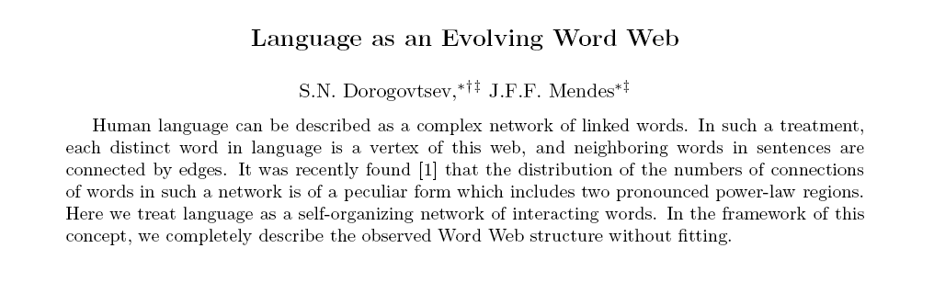
Word Co-occurrence Network
distinct
neighboring
interacting
structure
Words are nodes.
Two words are connected by an edge if they are adjacent in a sentence (directed, weighted)
word
web
evolving
sentences
in
treat
Proc of the Royal Society of London B, 268, 2603-2606, 2001
such
language
can
complex
a
human
is
as
network

Slide 23
Topological characteristics of WCN
R. Ferrer-i-Cancho and R. V. Sole. The small world of human language. Proceedings of The Royal Society of London. Series B, Biological Sciences, 268(1482):2261 -2265, 2001
R. Ferrer-i-Cancho and R. V. Sole. Two regimes in the frequency of words and the origin of complex lexicons: Zipf's law revisited. Journal of Quantitative Linguistics, 8:165 - 173, 2001
WCN for human languages are small world → accessing mental lexicon is fast.
The degree distribution of WCN follows two-regime power law → core and peripheral lexicon

Slide 24

Degree Distribution (DD)
Let p_{k} be the fraction of vertices in the network that has a degree k.
The k versus p_{k} plot is defined as the degree distribution of a network
For most of the real world networks these distributions are right skewed with a long right tail showing up values far above the mean – p_{k} varies as k^{-α}
  Cumulative degree distribution is plotted

Slide 25
Compute the degree distribution of the following network
distinct
neighboring
interacting
structure
word
web
evolving
sentences
in
treat
such
language
can
complex
a
human
is
as

Slide 26
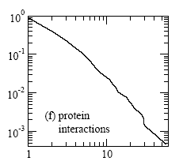
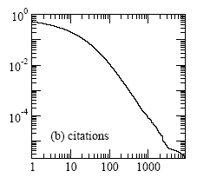
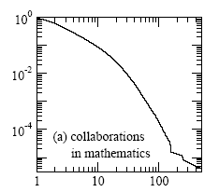
A Few Examples
Power law: P_{k} ~ k^{-α}

Slide 27
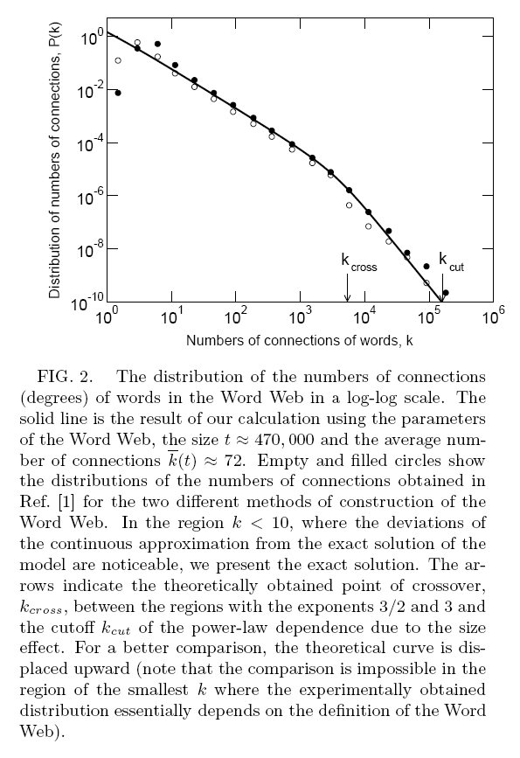
WCN has two regime power-law
Low degree words form the peripheral lexicon
High degree words form the core lexicon

Slide 28
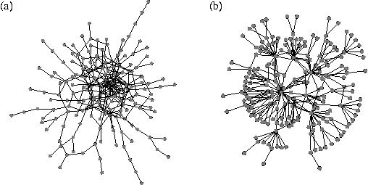
Core-periphery Structure
Core: A densely connected set of fewer nodes
Periphery: A large number of nodes sparsely connected to core-nodes
Fractal Networks: Recursive core-periphery structure
ML has a core-periphery structure (perhaps recursive)
  Core lexicon = function words plus generic concepts
  Peripheral lexicon = jargons, specialized vocabulary

Slide 29
Topological characteristics of WCN
R. Ferrer-i-Cancho and R. V. Sole. The small world of human language. Proceedings of The Royal Society of London. Series B, Biological Sciences, 268(1482):2261 -2265, 2001
R. Ferrer-i-Cancho and R. V. Sole. Two regimes in the frequency of words and the origin of complex lexicons: Zipf's law revisited. Journal of Quantitative Linguistics, 8:165 - 173, 2001
The degree distribution of WCN follows two-regime power law → core and peripheral lexicon
WCN for human languages are small world → accessing mental lexicon is fast.

Slide 30
Small World Phenomenon
A Network is small world iff it has
  Scale-free (power law) degree distribution
  High clustering coefficient
  Small diameter (average path length)

Slide 31
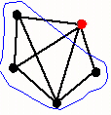
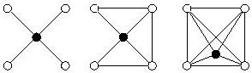
Measuring Transitivity: Clustering Coefficient
The clustering coefficient for a vertex ‘v’ in a network is defined as the ratio between the total number of connections among the neighbors of ‘v’ to the total number of possible connections between the neighbors
High clustering coefficient means my friends know each other with high probability – a typical property of social networks

Slide 32
Mathematically…
The clustering coefficient of a vertex i is
The clustering coefficient of the whole network is the average
Alternatively,
C_{i} =
# of links between ‘n’ neighbors
n(n-1)/2
1
∑C_{i}
C=
N
C =
# triangles in the n/w
# triples in the n/w

Slide 33
Diameter of a Network
Diameter of a network is the length of the longest smallest path among all pairs of vertices.
A network with N nodes is said to be small world if the diameter scales as log(N)
6 degrees of separation!
distinct
neighboring
interacting
structure
word
web
evolving
sentences
in
treat
such
language
can
complex
a
human
is
as
network

Slide 34
Which of these are Small World N/ws?
human
Tree
structure
as
word
structure
web
can
neighboring
word
web
language
sentences
in
treat
in
such
web
is
such
complex
sentences
in
treat
a
complex
a
such
language
can
network
human
is
as
Star
Path (or line graph)

Slide 35
WCN are small worlds!
Activation of any word will need only a very few steps to activate any other word in the network
Thus, spreading of activation is really fast
Lesson: ML has a topological structure that supports very fast spreading of activation and thus, very fast lexical access.

Slide 36
Self-organization of WCN
Dorogovtsev-Mendes Model
distinct
neighboring
* A new node joins the network at every time step t.
* It attaches to an existing node with probability proportional to degree
* ct new edges are added proportional to degrees of existing nodes
interacting
structure
word
web
evolving
sentences
in
treat
Proc of the Royal Society of London B, 268, 2603-2606, 2001
such
language
can
complex
a
human
is
as
network

Slide 37
DM Model leads to two regime power-law networks
k_{cut} ∼ √(t/8)(ct)^{3/2}
k_{cross} ≈ √(ct)(2+ct)^{3/2}

Slide 38
Significance of The DM Model
Topological significance
  Apart from degree distribution, what other properties of WCN can and cannot be explained by the DM model
Linguistic and Cognitive Significance
  What linguistic/cognitive phenomenon is being modeled here?
  What is the significance of the parameter c.

Slide 39
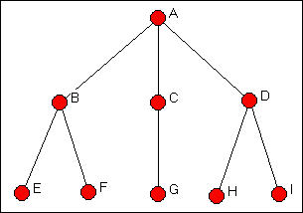
Structural Equivalence (Similarity)
Two nodes are said to be exactly structurally equivalent if they have the same relationships to all other nodes.
Computation:
Let A be the adjacency matrix.
Compute the Euclidean Distance /Pearson Correlation between a pair or rows/columns representing the neighbor profile of two nodes (say i and j). This value shows how much structurally similar i and j are.

Slide 40
Probing Deeper than Degree Distribution
Co-occurrence of words are governed by their syntactic and semantic properties
Therefore, words occurring in similar context has similar properties (distribution)
Structural Equivalence: How similar are the local neighborhood of the two nodes?
Social Roles – Nodes (actors) in a social n/w who have similar patterns of relations (ties) with other nodes

Slide 41
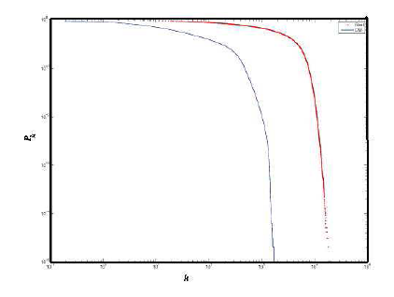
  Structural Similarity Transform
Degree distribution of real and DM networks after taking structural similarity transforms
Lesson: DM Model cannot take into account the distributional properties of words and hence it is topologically different from WCNs

Slide 42
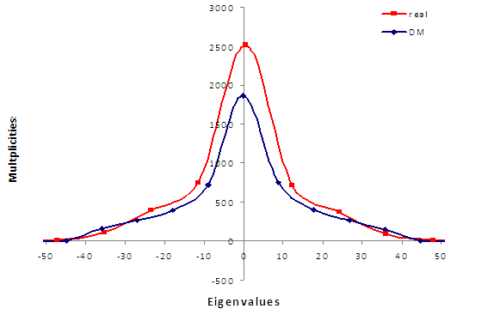
  Spectral Analysis
Reflects the global topology of the network through the distributions of eigenvalues and eigenvectors of the Adjacency matrix
Spectral Analysis shows that real networks are much more structured than those generated by DM Model

Slide 43
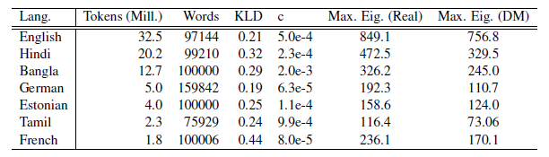
Global Topology of WCN:
Beyond the two-regime power law
Choudhury et al., Coling 2010

Slide 44
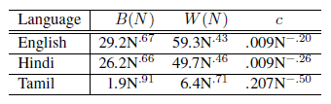
Significance of Parameter c in DM Model
t (also, #nodes) is actually the rate of seeing a new unigram (which varies with corpus size N)
#Edges is the number of unique bigrams
c is a function of N !!

Slide 45
Things you know
Topological properties:
  Degree distribution, Small world, Path lengths, Structural equivalence, core-periphery structure, fractal networks, spectrum of a network
Types of networks
  Power-law, two-regime power-law, core-periphery, trees or hierarchical, small world, cliques, paths
Network Growth Models
  Preferential attachment, DM model

Slide 46
Things to explore yourself
More node properties:
  Clustering coefficient: friends of friends are friends
  Centrality: Degree, betweenness, eigenvector centrality
Types of Networks
  Assortative, super-peer
Community Analysis
  Definitions and Algorithms
Random networks
neighboring
interacting
structure
word
web
evolving
sentences
in
treat
such
language
can
complex
a
human
is
as

Slide 47
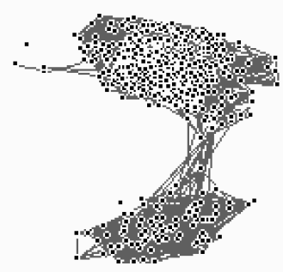
Phonological Neighborhood Networks
2-4 segment words
Removal of low-degree nodes disconnect the n/w as opposed to the removal of hubs like “pastor” (deg. =112)
8-10 segment words

Slide 48
CASE STUDY II:
Unsupervised POS Tagging

Slide 49
Labeling of Text
Lexical Category (POS tags)
Syntactic Category (Phrases, chunks)
Semantic Role (Agent, theme, …)
Sense
Domain dependent labeling (genes, proteins, …)
How to define the set of labels?
How to (learn to) predict them automatically?

Slide 50
What are Parts-of-Speech (POS)?
Distributional Hypothesis: “A word is characterized by the company it keeps” – Firth, 1957
The X is a …
You Y that, did not you?
Part-Of-Speech (POS) induction
  Discovering natural morpho-syntactic classes
  Words that belong to these classes

Slide 51
1: Acquire raw text corpus
In the context of network theory, a complex network is a network (graph) with non-trivial topological features—features that do not occur in simple networks such as lattices or random graphs. The study of complex networks is a young and active area of scientific research inspired largely by the empirical study of real-world networks such as computer networks and social networks. Most social, biological, and technological networks display sub-stantial non-trivial topological features, with patterns of connection between their elements that are neither purely regular nor purely random.
বাংলা সাহিত্যের মধ্যযুগে বিশেষ এক শ্রেণীর ধর্মবিষয়ক আখ্যান কাব্য মঙ্গলকাব্য নামে পরিচিত। বলা হয়ে থাকে, যে কাব্যে দেবতার আরাধনা, মাহাত্য-কীর্তন করা হয়, যে কাব্য শ্রবণেও মঙ্গল হয় এবং বিপরীতে হয় অমঙ্গল; যে কাব্য মঙ্গলাধার, এমন কি, যে কাব্য যার ঘরে রাখলেও মঙ্গল হয় তাকে বলা হয় মঙ্গলকাব্য। মঙ্গলকাব্য বিশেষ হিন্দু দেবতা যারা “নিম্নকোটি” নামে পরিচিত ছিল তাদের মাহাত্ম বর্ণণায় ব্যবহৃত হত বলে ইতিহাসবিদেরা মনে করেন কেননা এগুলো শাস্ত্রীয় হিন্দু সাহিত্য যেমন বেদ ও পুরাণে অনুল্লেখ্য ছিল।
http://www.wikipedia.org/

Slide 52
1: Acquire raw text corpus
In the context of network theory, a complex network is a network (graph) with non-trivial topological features—features that do not occur in simple networks such as lattices or random graphs. The study of complex networks is a young and active area of scientific research inspired largely by the empirical study of real-world networks such as computer networks and social networks. Most social, biological, and technological networks display sub-stantial non-trivial topological features, with patterns of connection between their elements that are neither purely regular nor purely random.
Feature word
http://en.wikipedia.org/wiki/Complex_network

Slide 53
1: Acquire raw text corpus
In the context of network theory, a complex network is a network (graph) with non-trivial topological features—features that do not occur in simple networks such as lattices or random graphs. The study of complex networks is a young and active area of scientific research inspired largely by the empirical study of real-world networks such as computer networks and social networks. Most social, biological, and technological networks display sub-stantial non-trivial topological features, with patterns of connection between their elements that are neither purely regular nor purely random.
Target word
Feature word
http://en.wikipedia.org/wiki/Complex_network

Slide 54
2: Construct context vectors
In the context of network theory, a complex network is a network (graph) with non-trivial topological features—features that do not occur in simple networks such as lattices or random graphs. The study of complex networks is a young and active area of scientific research inspired largely by the empirical study of real-world networks such as computer networks and social networks. Most social, biological, and technological networks display substantial non-trivial topological features, with patterns of connection between their elements that are neither purely regular nor purely random.
networks | of | a | and | is | as | PU | … | the
-2 | 2 | 0 | 2 | 0 | 1 | 0 | … | 0
-1 | 0 | 0 | 0 | 0 | 0 | 0 | … | 0
1 | 0 | 0 | 1 | 1 | 0 | 1 | … | 0
2 | 0 | 1 | 0 | 0 | 2 | 0 | … | 0

Slide 55
3: Construct network
Words are nodes. The weight of the edge between nodes (words) u and v is:
  sim(u,v) = cos(u, v )
occur
purely
substantial
pattern
elements
inspired
display
network
networks
most
graphs
young
complex
social
computer
features
regular
graph
simple
random
study
active
lattices
area

Slide 56
Experiments
Cluster the Network
  Hierarchical clustering
  Random walk based clustering
Study the topological properties of the networks across languages
Develop unsupervised POS tagger

Slide 57
Languages
Bangla (2M, ABP)
Catalan (3M, LCC)
Czech (4M, LCC)
Danish (3M, LCC)
Dutch (18M, LCC)
English (6M, BNC)
Finnish (11M, LCC)
French (3M, LCC)
German (40M, Wortschatz)
Hindi (2M, DJ)
Hungarian (18M, LCC)
Icelandic (14M ,LCC)
Italian (9M, LCC)
Norwegian (16M, LCC)
Spanish (4.5M, LCC)
Swedish (3M, LCC)
http://wortschatz.uni-leipzig.de/~cbiemann/software/unsupos.html

Slide 58
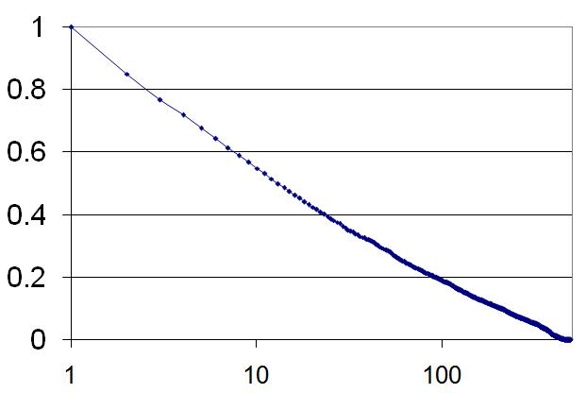
Structural Properties:
Degree Distribution
Power-law with exponent -1
(Zipf Distribution)
P_{k}
k
Inference: Hierarchical organization of the morpho-syntactic ambiguity classes.

Slide 59
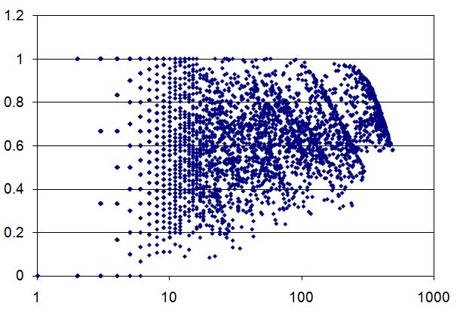
Structural Properties:
Clustering Coefficient
Community structure;
Frequent words connect to frequent words (rich club phenomenon),
Existence of a large core
CC
k
Avg. CC = 0.53
High k → High CC
(Pearson = 0.49)

Slide 60
Clustering Algorithms
Crisp/hard vs. Fuzzy/soft
Hierarchical vs. non-hierarchical
Divisive vs. Agglomerative
Popular strategies
  k-means
  Hierarchical agglomerative clustering
  Spectral clustering (Shi-Malik algorithm)

Slide 61
Syntactic Network of Words
color
sky
weight
light
1
blue
20
100
blood
heavy
1
1 – cos(red, blue)
red

Slide 62
The Chinese Whispers Algorithm
color
sky
0.9
weight
0.8
light
-0.5
blue
0.7
0.9
blood
heavy
0.5
red

Slide 63
The Chinese Whispers Algorithm
color
sky
0.9
weight
0.8
light
-0.5
blue
0.7
0.9
blood
heavy
0.5
red

Slide 64
The Chinese Whispers Algorithm
color
sky
0.9
weight
0.8
light
-0.5
blue
0.7
0.9
blood
heavy
0.5
red

Slide 65
Structural Properties:
Cluster Size Distribution
Power-law with exponent close to -1
size
rank
Inference: Fractal nature of the Network

Slide 66
The Clusters
Bangla
Finnish
গোলমালের, দাবির, আগুনের, ফলের, মনোভাবের, দূষণের, ব্যয়ের, মাথার, কথার, বোধের …
(352) Genitive Nouns
kaksi, kaksi-kolme, viiteen, vajaata, 22:een, miljoona, 40-vuotiaan …
Quantifiers (199)
(189) Adverbs
defiantly, steadily, uncertainly, abruptly, thoughtfully, neatly, uniformly, freely, upwards, aloud, sidelong, savagely …
Adjectives (590)
chinesischer, Deutscher, nationalistischer, grüner, tamilischer, indianischer, amerikanischer …
English
German

Slide 67
Proper Nouns
Bangla
Finnish
Blair, Singh, Azad, Chowdhury, Kumar, Ganguly, Khan, Gandhi, Das, Basu, Roy, Sen, Bush, …
(102) Surnames
Eemil, J-P, Benedictus, Jarl, James, Kristian, Petra, El, Dave, Otto, Bo, Mirka …
First Names (919)
(988) Places
Punjab, Spain, Vienna, Chicago, Antarctica, Gibraltar, Carnegie, Zambia, North-East, England, Bangladesh, India, USA, Yorks …
Acronyms (2884)
WIZO, IPOs, FDD, KDA, CIC, IMB, VDP, FIBT, DBAG, G7, DOG, WJC, Eucom, WWF, BfV, L-Bank, MuZ, ORH …
English
German

Slide 68
Clusters in Bangla
Cluster 1: Proper Nouns
buddhabAbu, saurabha, rAkesha
Cluster 2: Noun-genitive
golamAlera (of problem), dAbira (of right), phalera (of result)
Cluster 3: Quantifiers
sAtaTi (seven), anekaguli (many), 3Ti (three)
Cluster 4: Noun-locative
adhibeshane (during the session), dalei (in party), baktritAYe (in speech), bhAShaNe (in speech)
Cluster 5: Infinitives
bhAbte (to think), khete (to eat), jitate (to win)

Slide 69
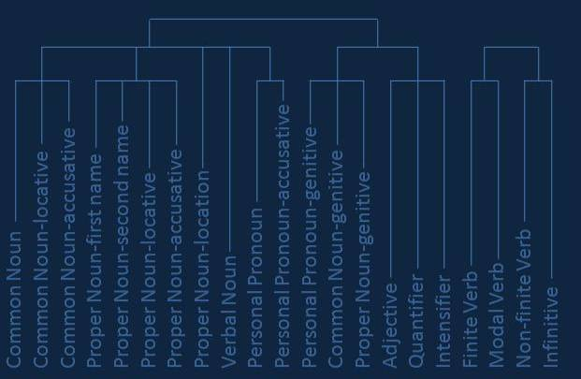
Dendogram of POS in Bangla

Slide 70
Lexicon Induction and Labeling
Fuzzy clusters define lexical categories
Induction of lexicon
Use lexicon to train HMM in an unsupervised manner
Evaluation: Tag perplexity
Result: Improves accuracy of NER, Chunking etc. over no POS tagging, but supervised POS tagging still better

Slide 71
Word Sense Disambiguation
Véronis, J. 2004. HyperLex: lexical cartography for information retrieval. Computer Speech & Language 18(3):223-252.
Let the word to be disambiguated be “light”
Select a subcorpus of paragraphs which have at least one occurrence of “light”
Construct the word co-occurrence graph

Slide 72
HyperLex
A beam of white light is dispersed into its component colors by its passage through a prism.
Energy efficient light fixtures including solar lights, night lights, energy star lighting, ceiling lighting, wall lighting, lamps
What enables us to see the light and experience such wonderful shades of colors during the course of our everyday lives?
beam
prism
white
dispersed
colors
shades
energy
efficient
fixtures
lamps

Slide 73
Hub Detection and MST
light
beam
prism
white
dispersed
colors
lamps
colors
shades
beam
prism
fixtures
energy
shades
energy
efficient
white
dispersed
efficient
fixtures
White fluorescent lights consume less energy than incandescent lamps
lamps

Slide 74
Other Related Works
Solan, Z., Horn, D., Ruppin, E. and Edelman, S. 2005. Unsupervised learning of natural languages. PNAS, 102 (33): 11629-11634
Ferrer i Cancho, R. 2007. Why do syntactic links not cross? Europhysics Letters
Also applied to: IR, Summarization, sentiment detection and categorization, script evaluation, author detection, …

Slide 75
One slide summary
Computer science has a much bigger role to play in understanding language than the scope of NLP today
A holistic research agenda in computational linguistics is the need of the hour
Research in linguistic networks is an emerging area with tremendous potentials
Graphs are amazing tools for visualization – and therefore teaching

Slide 76
Resources
Conferences
  TextGraphs, Sunbelt, EvoLang, ECCS
Journals
  PRE, Physica A, IJMPC, EPL, PRL, PNAS, QL, ACS, Complexity, Social Networks, Interaction Studies
Tools
  Pajek, C#UNG, http://www.insna.org/INSNA/soft_inf.html
Online Resources
  Bibliographies, courses on CNT

Slide 77
Thank you monojitc@microsoft.com

